Slide 1


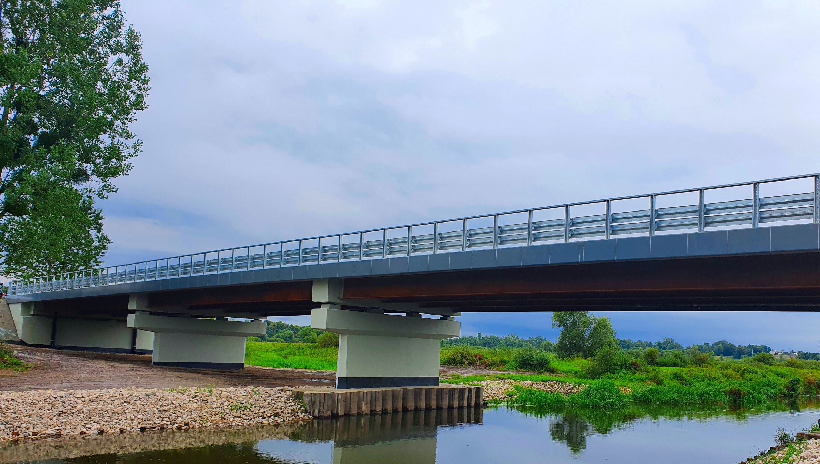

Weathering Steel Bridges
The New European ECCS Design Guide
June 16th 2022
Dennis Rademacher, Peter Hatke
Contact:
Dr.-Ing. Mike Tibolt
Steligence® Construction Engineer
Tel: +352 5313 2719
mike.tibolt@arcelormittal.com
***Changing imagery***
1 Right click on the image and select ‘Change picture’
2 Choose your replacement
3 Use the crop tool to scale and position within the shape

Slide 2
EN 10025:2019 –
Hot rolled products of structural steels
Parts:
1: General technical delivery condition
2: Non-alloy steels, R_{e} = 235 → 460
3: Fine grain weldable normalized steels, R_{e} = 275 → 460
4: Fine grain weldable thermomechanical steels,
R_{e} = 275 → 500
5: Weathering steels, R_{e} = 235 → 460
6: Quenched and tempered steels, R_{e}: 460 → 960
+AR, +N, +M
N
M
W
Q
Notes:
Now we continue with the weathering steel grades, which a defined in part five of EN 10025

Slide 3


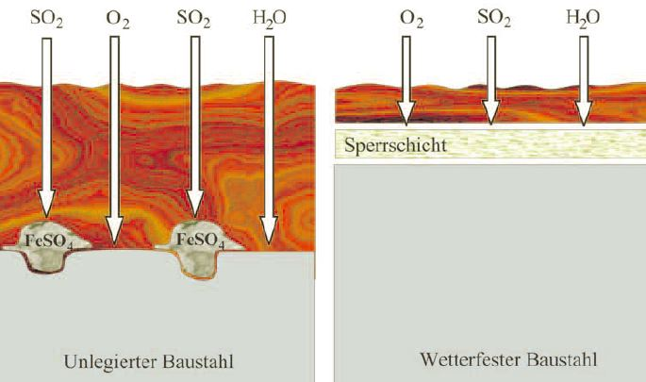
EN 10025-5:2019
Weathering steel
Weathering steel is a low-alloy steel, alloying elements Copper, Chromium, (Nickel, Phosphorus)
Mechanical characteristics (almost) the same as for carbon steel acc. to EN 10025-2
Alloying elements form a protective, firm adhering und dense oxide layer (patina) under influence of water, oxygen and sulfur dioxide SO₂
The formation of the patina needs alternating wet and dry cycles
Patina slows further corrosion, serves as a barrier and is able to renew itself
Self protection against corrosion by protective oxide patina
➔ no need for paint or for other corrosion protection
Firmly adhering, dense rust layer: PATINA
Further oxidation strongly reduced
Non-alloy steel
Weathering steel
Notes:
The mechanical characteristics of weathering steel are (almost) the same as for ordinary carbon steel, although it is lowly alloyed with Copper, Chromium, Nickel and sometimes Phosphorus. With Phosphorus alloyed steels you have to be careful, because they are less or even not suitable for welded constructions. The reason is the too high carbon equivalent
The patina slows the further corrosion, serves as a barrier and is able to renew itself
Conditions of alternate wetting and drying produce a protective barrier which impedes further access to oxygen and moisture

Slide 4
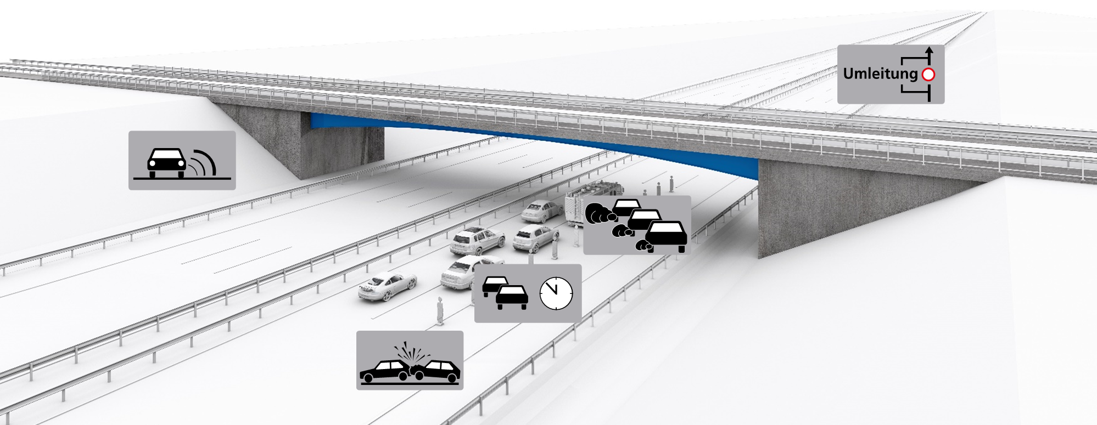
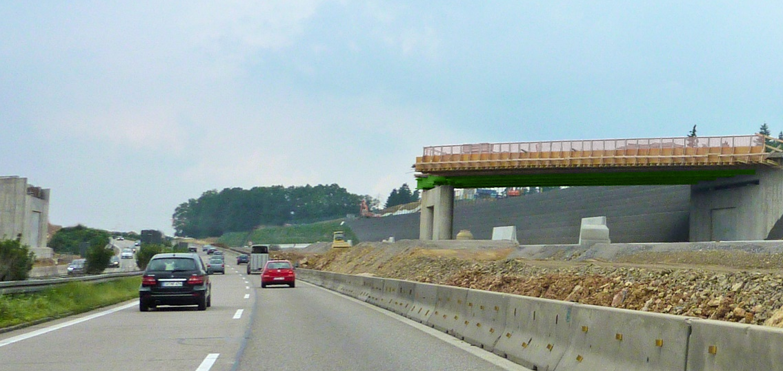
Benefits of using weathering steel in bridges
Life-Cycle Costs
Comparison of the life-cycle costs (LCC) with a discount rate of 1% ➔ 7% savings
Comparison of external costs for the condition-based maintenance strategy and an average daily traffic of 40,000 vehicles per day for a reference rural highway viaduct (total bridge construction incl. steel superstructure, substructure, roadway, planning and site equipment) in absolute values ➔ 10% savings

Slide 5
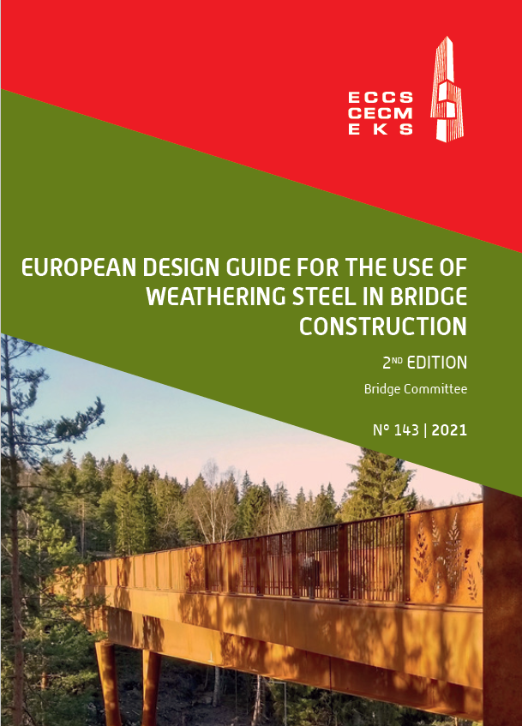

ECCS Design guide
Best practice from many European countries
incl. S460W
Recommendations for detailing
Free download:
https://www.steelconstruct.com/wp-content/uploads/ECCS-Design-Guide-Weathering-Steel-Bridges_FINAL.pdf
Now:
New European Design Guide

Slide 6
Weathering Steel
Design rules and Details to avoid wetness
Eurocode 3 : Design of Steel Structure (EN 1993-1-1)
  Weathering steel plates and sections are covered by EC3
  Additional guidelines do exist
Avoid details which can collect and retain moisture, such as
  “Pockets”
  Crevices
Provide adequate drainage and ventilation to enable drying of steel
Notes:
5
Drainage is to be considered, as weathering steel should not be permanently wet
➔ ensure that continual wetness do not occur at any point of the construction

Slide 7
Weathering steel –
Corrosivity classes and corrosion loss
Environmental conditions (weathering, environment, pollution, etc.) | Possible corrosivity category
indirect weathering (no direct rain) and good ventilation rural or urban atmosphere with less industry low air pollution (SO₂ ≤ 5 µg/m³) and no significant chlorides (Cl ≤ 3 mg/(m²·d)) | C2
direct weathering (direct rain) and good ventilation rural or urban atmosphere with less industry low air pollution (SO₂ ≤ 5 µg/m³) and no significant chlorides (Cl ≤ 3 mg/(m²·d)) | C2 – C3 strongly dependent on temperature and humidity
direct or indirect weathering and good ventilation urban atmosphere with industry moderate air pollution (5 µg/m³ < SO₂ ≤ 30 µg/m³) or low chlorides (3 mg/(m²·d) < Cl ≤ 60 mg/(m²·d)) | C3
direct or indirect weathering and bad ventilation or moisture trapping (e.g. by dirt nests) rural or urban atmosphere with industry up to moderate air pollution (5 µg/m³ < SO₂ ≤ 30 µg/m³) or low chlorides (3 mg/(m²·d) < Cl ≤ 60 mg/(m²·d)) | C4
direct weathering and good ventilation urban / industrial atmosphere with heavy industry high air pollution (30 µg/m³ < SO₂ ≤ 90 µg/m³) | C3 – C4 strongly dependent on temperature and humidity
direct or indirect weathering and good ventilation coastal areas (outside saltwater spray) or possible influence by de-icing salt spray significant chlorides (60 mg/(m²·d) < Cl ≤ 300 mg/(m²·d)) | C4 strongly dependent on temperature and humidity
Country | Allowances for the loss of thickness related to corrosion classification in EN ISO 9223
 | C1 | C2 | C3 | C4 | C5
Belgium | - | 0.11 - 0.8 | 0.53 - 1.2 | 1.05 - 1.5 | not allowed
Germany | - | 0.8 | 1.2 | 1.5 | not allowed
United Kingdom (for 120 years) | 0.0 | 0.5 | 1.0 | 1.5 | not allowed
France | not applicable | 1.0 | 1.0 | 1.0 | not allowed
Spain (exterior elements) | 1.0 | 1.0 | 1.0 | not allowed | not allowed
ECCS recommendation for bridges | not applicable | 0.8 | 1.0 | 1.5 | not allowed

Slide 8
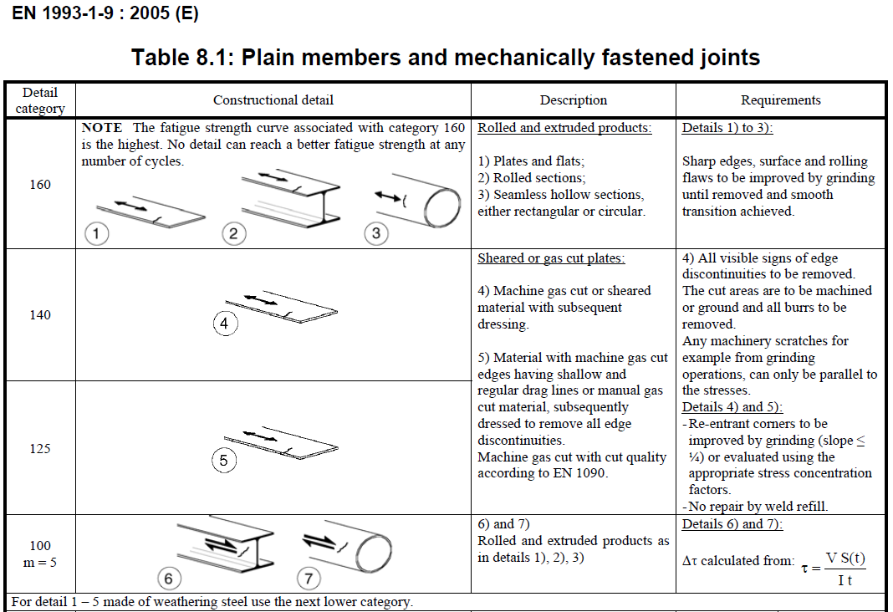
Fatigue design for weathering steel
To be noted in EN 1993-1-9
Same detail categories for weathering steel like for non-alloyed and fine-grain steels
Do not miss small note in Table. 8.1!
Only details 1-5 in table 8.1 to be lowered by one category

Slide 9
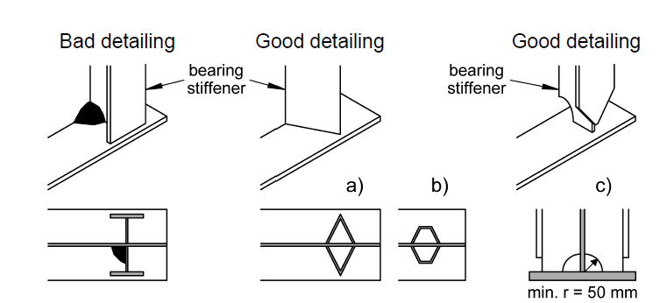
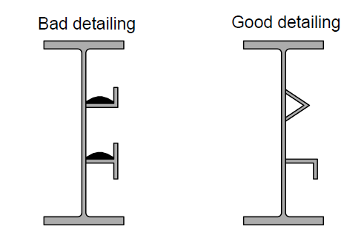
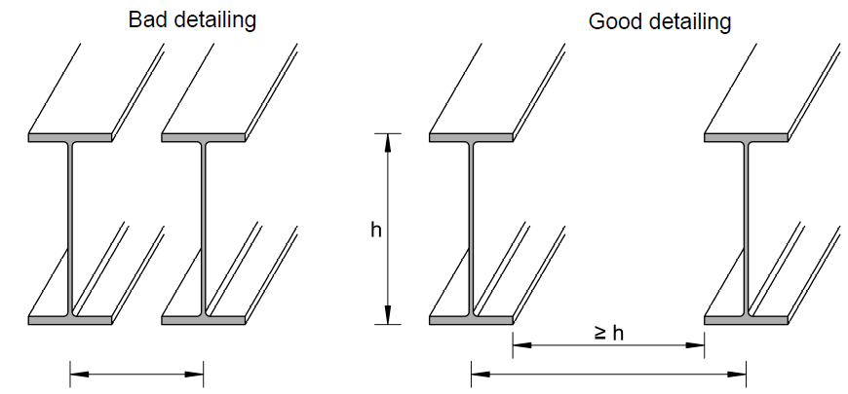
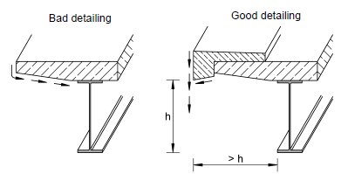
Details to avoid wetness
Avoid water stagnation
Sources: ECCS Design Guide for the Use of Weathering Steel in Bridge Construction
Notes:
8
Collection of dirt and water leads to accelerated corrosion

Slide 10
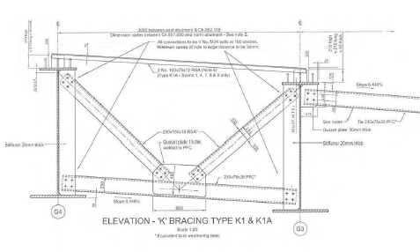
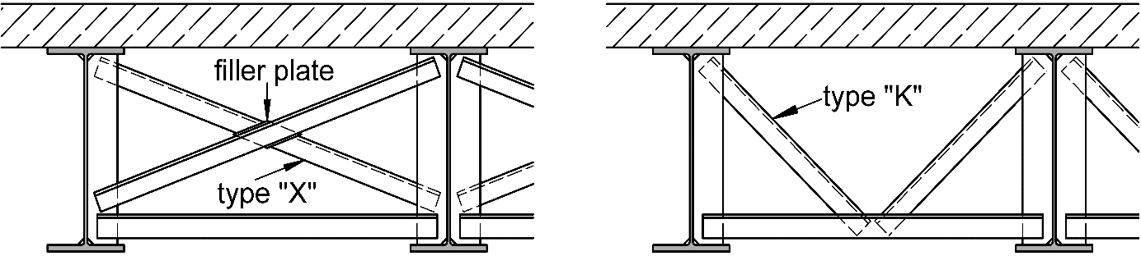
Bridge bracings (in weathering steel)
Avoid crevices
  can attract moisture by capillary action and can lead to local corrosion problems for bridges in uncoated weathering steel
  can occur at any point where two surfaces are in contact and are particularly serious at overlapping bolted connections
  use angles “flange upwards" and select "K” bracing rather than "X" bracing to avoid crevices at the intersections.
  If “X” bracing must be used, fill out the intersections with tightly fitting filler plates
Uses
200x150x15 RSA
230x75x26 PFC
Steel Bridges, BCSA Publication 51/10,
3rd Edition, 2010
Available Arcorox® sections
250x250 Equal Angle, 300x300 Equal Angle
From stock AMDS in UK:
150x150x12/15/20 & 200x200x16/20
PFC 380x100 & 300x90 (260x90 & 200x75)

Slide 11
Weathering Steel
Details to avoid staining
Run-off tends to contain rust from weathering process
Run-off water should not run down the visible surfaces
Notes:
10

Slide 12
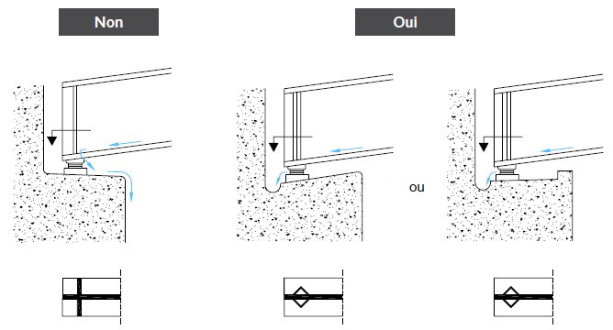
Details to avoid staining
Abutments: draining of water
Bad detailing
Good detailing
or
Sources: Centre information Acier; HERA report 4; RFCS; ECCS; DASt Richtlinie 007
Notes:
11
The upper photo shows a bad detailing, because water runs off over the concrete wall
This should be avoided by providing drainage channels and drainpipes

Slide 13
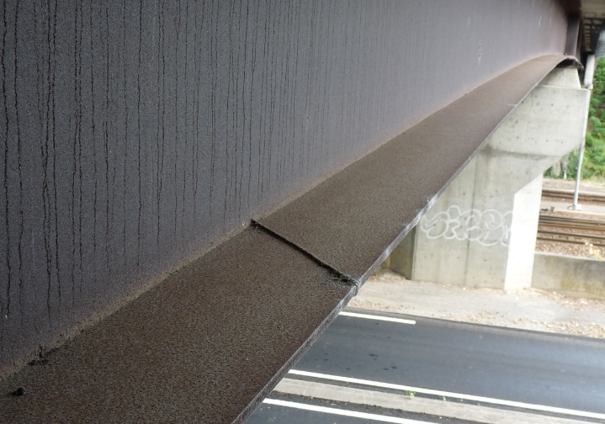
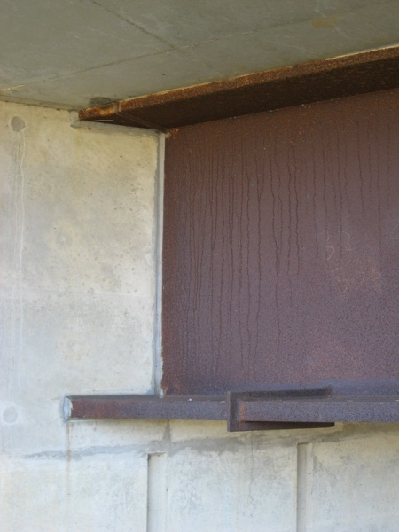
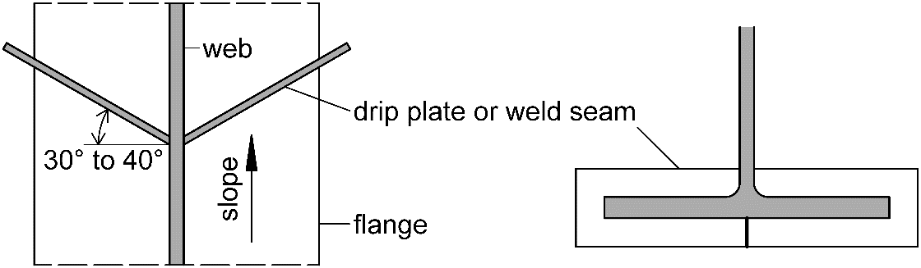
Details to avoid staining
Piers and abutments – dripping edges
Run-off from bottom flanges should occurs away from piers
  Use drip plates in the correct orientation, considering the slope of the bottom flange to avoid debris accumulation
  Alternative: welded seams or other suitable devices, such as glued PVC angles, can also be used as diversion strips
SteelConstruction.info
Notes:
12
The upper photo shows a bad detailing, because water runs off over the concrete wall
This should be avoided by providing drainage channels and drainpipes

Slide 14
Weathering Steel
Fabrication
Surface preparation
Cutting
Welding
Bolting
Galvanic corrosion
This section gives advices for finishing, but
➔ Always check standards and regulations
Notes:
13
Finally some recommendations for beam finishing and processing

Slide 15
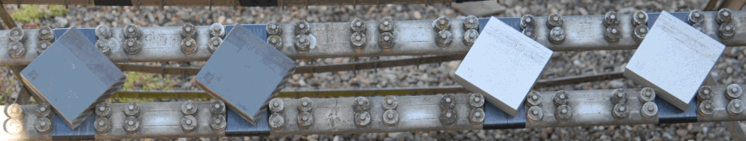
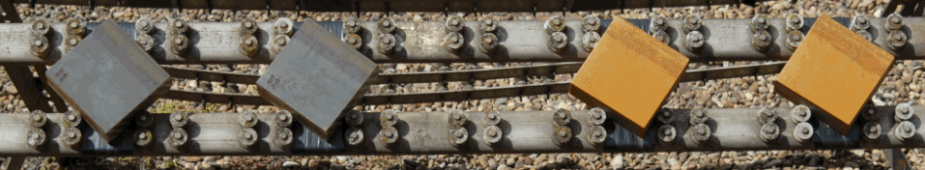
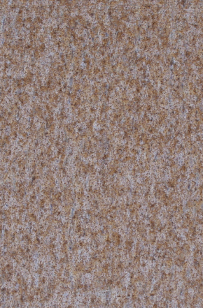
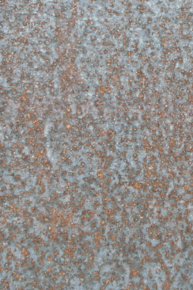
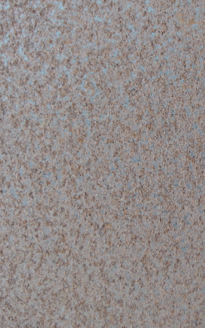
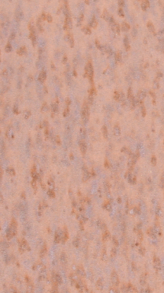
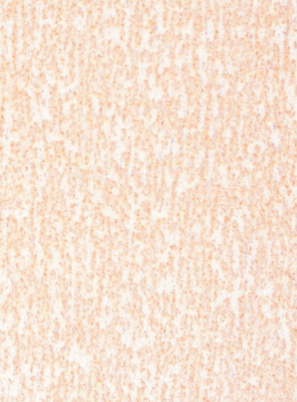
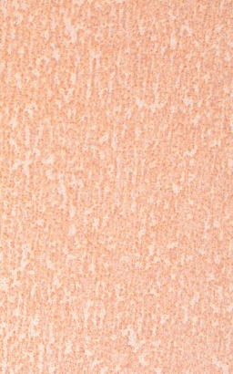
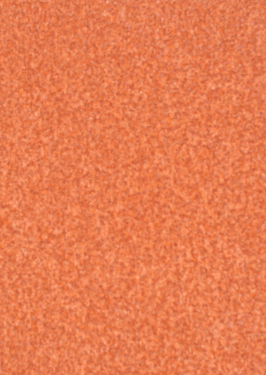
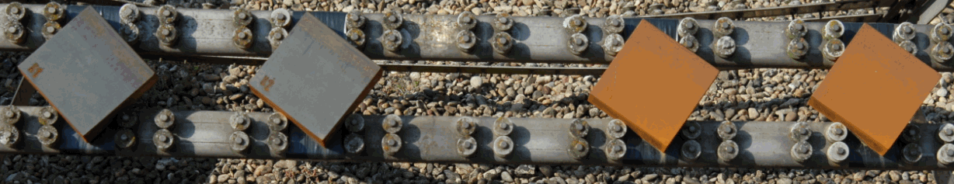
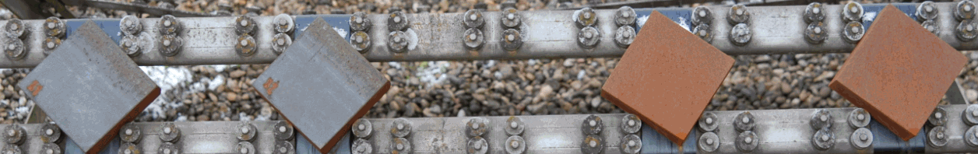
Surface preparation of weathering steel –
Aesthetic aspects
Example of surface evolution within 5 months
Sand blasting
➔ Regular patina and uniform coloring
Structure and colour depend on:
  Time & degree of exposure
  Atmospheric environment (rural/industrial)
Without blasting
With blasting
Outdoor exposure from 01.08.2010 to 14.12.2010 in Esch/Alzette (Lux.)
Notes:
Blast cleaning removes mill scale, oil, grease, dirt, rust scale --> the surface will weather uniformly

Slide 16
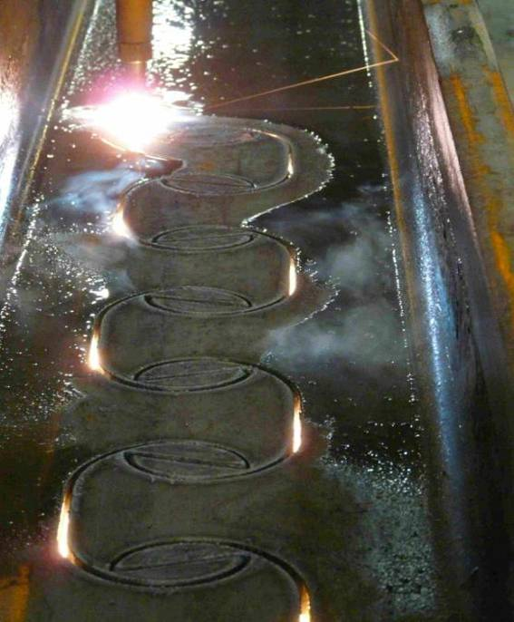
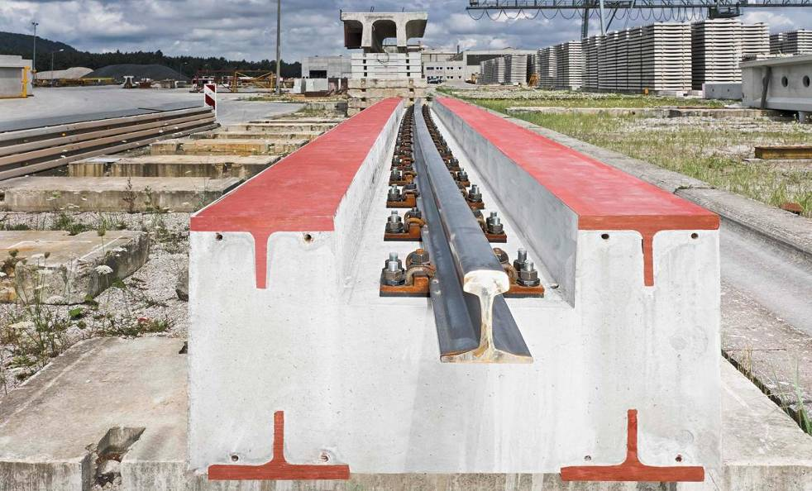
Cutting of weathering steel
Requirement for cutting
  Flame cutting or plasma-arc cutting using same procedures for steels of similar carbon equivalent value and thickness
  Application of preheat temperatures similar to those used for welding
  ➔ Avoid excessive hardening of the flame-cut edges
Notes:
Normal thermal cutting procedures can be applied

Slide 17
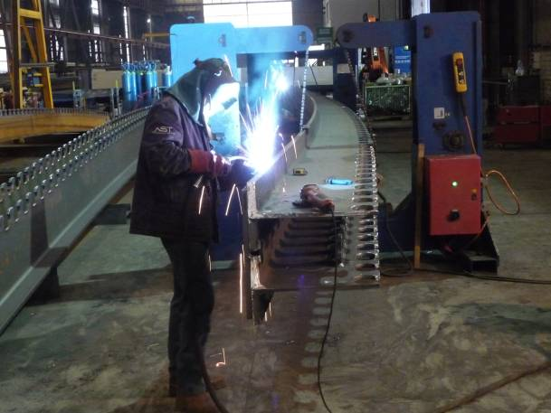
Welding of weathering steel
All manual and automatic welding processes according to general rules of welding
All joints should be continuously welded (avoid moisture and local contact corrosion)
Weld metal should:
  be adapted to the mechanical properties of the base metal
  have an atmospheric corrosion resistance ≥ resistance of the steel
  If multiple passes:
  ➔ no need for the submerged runs to have such a resistance
  EN 1090-2 gives welding consumables to be used with steel according to EN10025-5
Process | No. | Option 1 | Option 2 | Option 3
Shielded metal arc welding (SMAW) | 111 | Matching | 2.5 % Ni | 1 % Ni, 0.5 % Mo
Submerged arc welding (SAW) | 121,122 | Matching | 2 % Ni | 1 % Ni, 0.5 % Mo
Gas metal arc welding (GMAW) | 135 | Matching | 2.5 % Ni | 1 % Ni, 0.5 % Mo
Flux-cored arc welding (FCAW) | 136 | Matching | 2.5 % Ni | 1 % Ni, 0.5 % Mo
Matching: 0.5 % Cu and other alloy elements
Notes:
All usual manual and automatic welding processes are possible
All joints should be continuously welded (avoid moisture and local contact corrosion)
Weld metal should have an atmospheric corrosion resistance equal or greater than the resistance of the steel
If multiple passes: only the final layer needs a higher corrosion resistance
The submerged runs can be carried out with normal weld metal for non-alloy steels

Slide 18
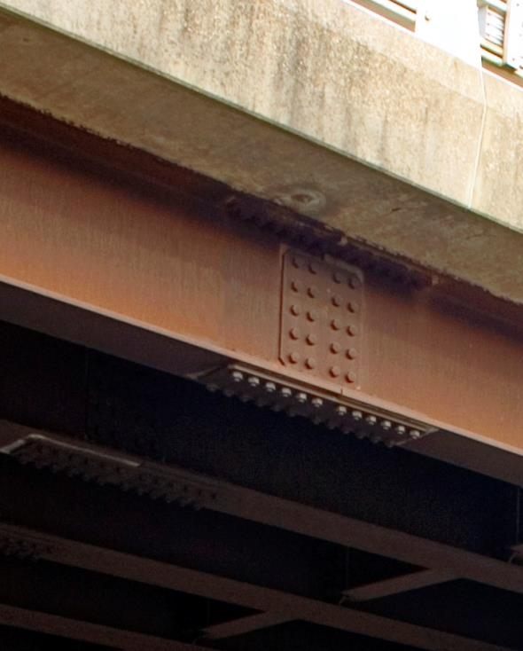
Bolted joints of weathering steel
Positioning of holes for bolts:
  Avoid moisture penetration
  Eurocode EN1993-1-8 gives specific spacing values for weathering steel
Choice of connection elements:
  Structural bolts: Bolts, nuts and washer available in weathering steel according to ASTM standard (including metric sizes): ASTM A325 and A490 (type 3)
  TCB is stocking M24 and M30 bolts (EN 14399-10)
Other:
  Stainless steel could also be used (no significant galvanic corrosion will occur)
  Galvanized steel should be avoided for fasteners
Notes:
17
There are special rules for edge and hole distances for weathering steels, which are slightly different
If you are not able to use weathering grades, you can also use stainless steel
Galvanized steel should be avoided!

Slide 19
Weathering Steel
Inspection and Maintenance
Similar rules as for “normal” steel and composite bridges
  Wet debris and aggressive substances to be removed from the steel surface
  Leaking joints or drainage elements to be identified and cleaned, repaired or replaced.
  For excessively corroded weathering steel surfaces, a subsequent protective painting may be necessary.
Crack detection with NDT possible
Notes:
18
Drainage is to be considered, as weathering steel should not be permanently wet
➔ ensure that continual wetness do not occur at any point of the construction

Slide 20
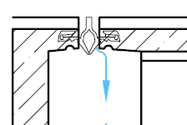
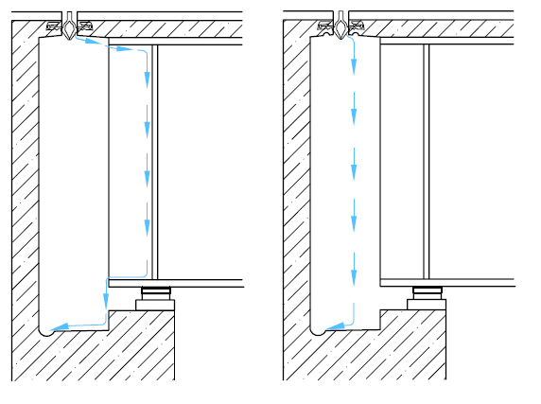
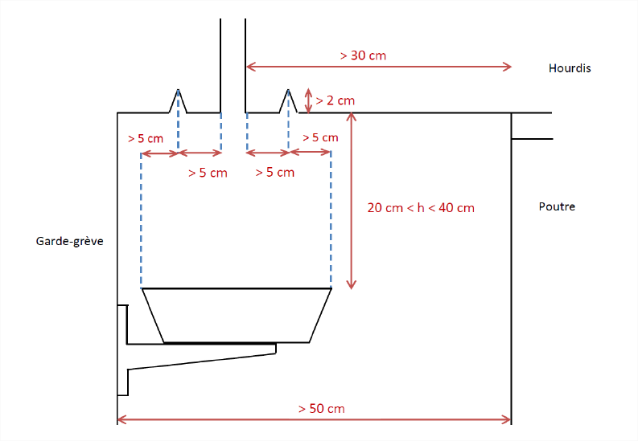
Maintenance and Inspections
Avoid problems with leaking joint
Bad detailing
Good detailing
(A)
Concrete deck
Beam
(B)
Preferable: watertight expansion joints
Consider: expansion joints can leak!
  Provide drip edges!
Abutment
Stainless steel
Sources: Centre information Acier; HERA report 4; RFCS; Cerema/IFSTTAR; ECCS; DASt Richtlinie 007
Notes:
19
Watertight expansion joints are preferable,
but for the case of a leak you should provide drip edges or drip pans of stainless steel

Slide 21
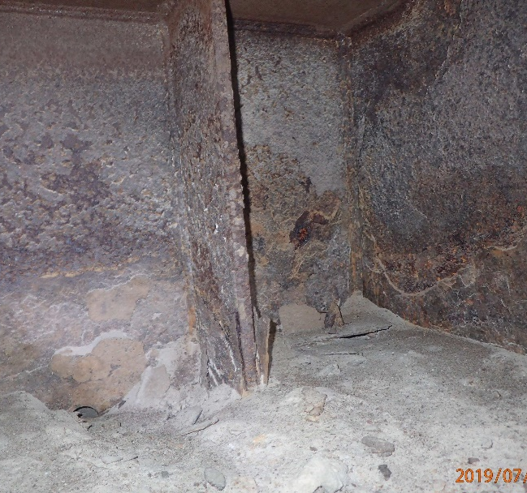
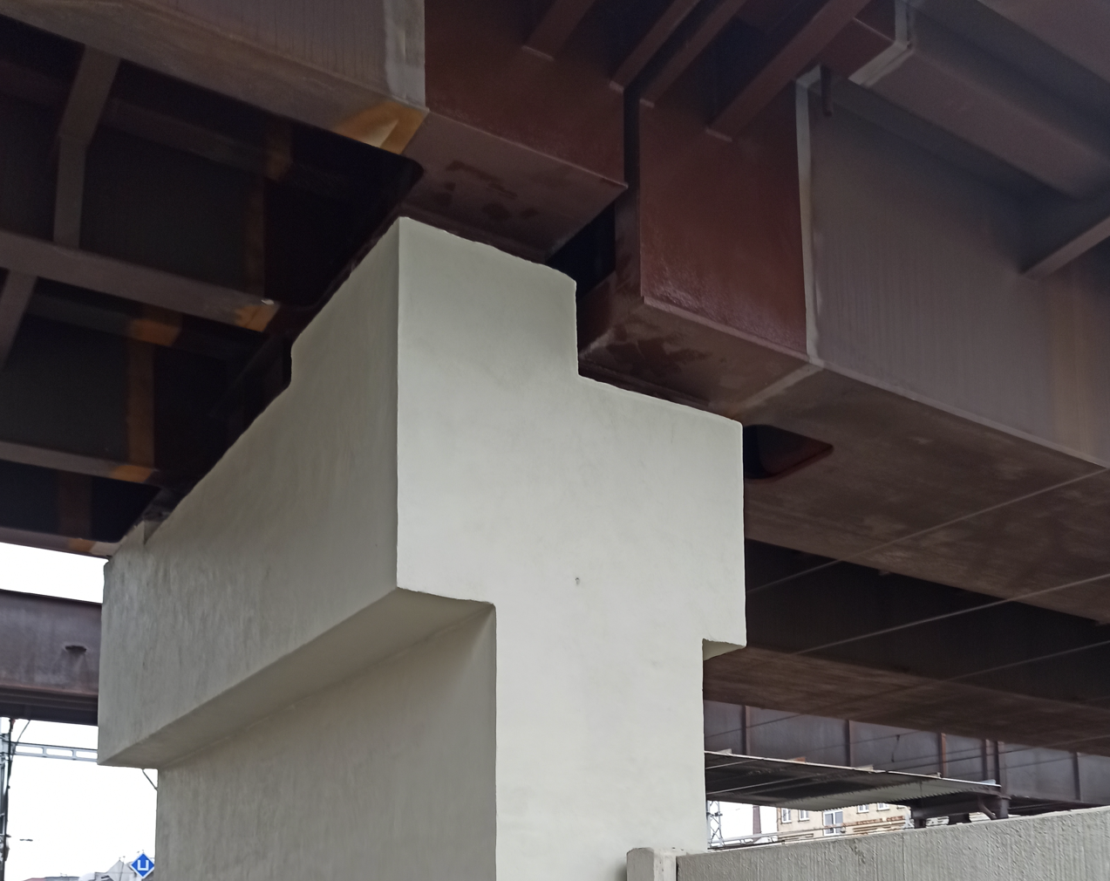
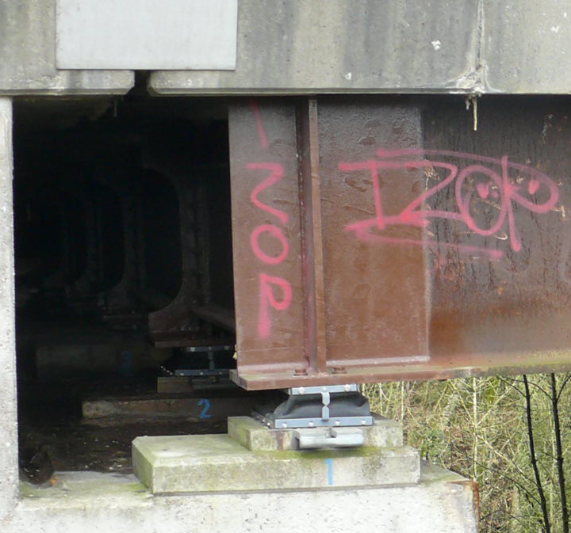
Maintenance and Inspections
Repair of damage caused by leaking joints
  Probably caused by a humid environment, by dirt and water as a result of a leaking expansion joint combined with a badly or not planned drainage system at the abutment.
  Removal of all loose rust layer
  Sealing of expansion joints
  Consider partial painting of beam ends, if leaking cannot be excluded or corrosion loss already too high.
Paint creates a protective layer of oxides which stop the rust underneath swelling. The excellent corrosion resistance of post-painted weathering steel is enhanced by the self-healing effect where scratches occur.

Slide 22
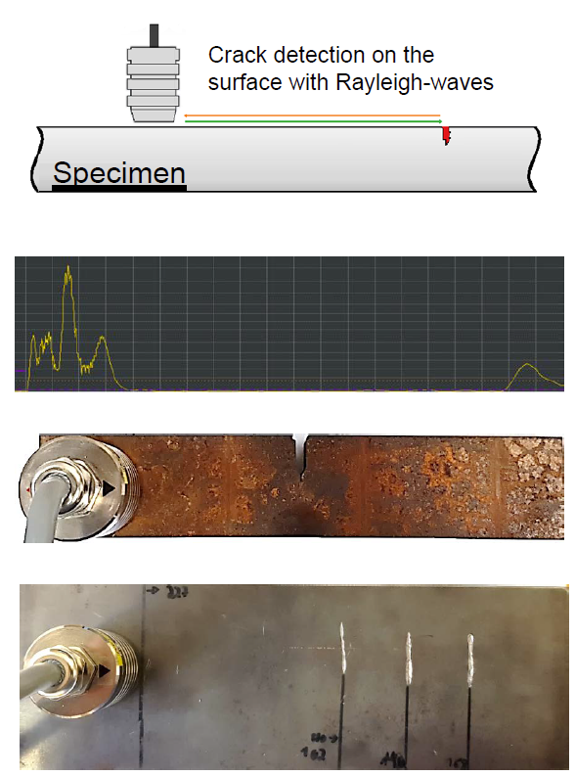
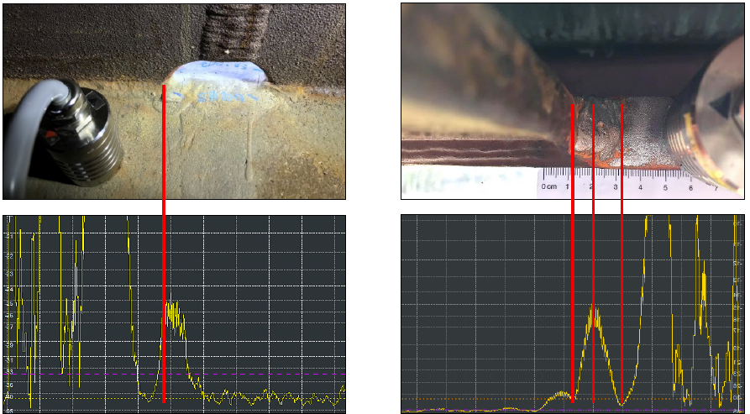
Maintenance and Inspections
Crack Detection with EMAT (Electro Magnetic Acoustic Transducer)
Also possible under patina without removal of rust layer
First tests at TU Dortmund University show very promising results,
to be further developed
Notes:
Kind of UT

Slide 23
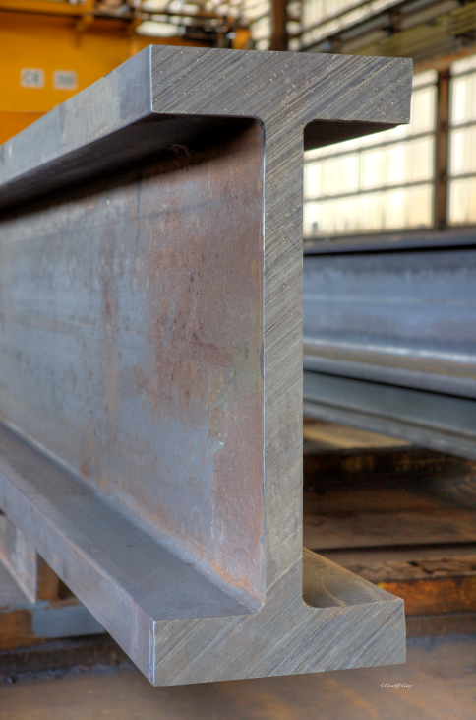
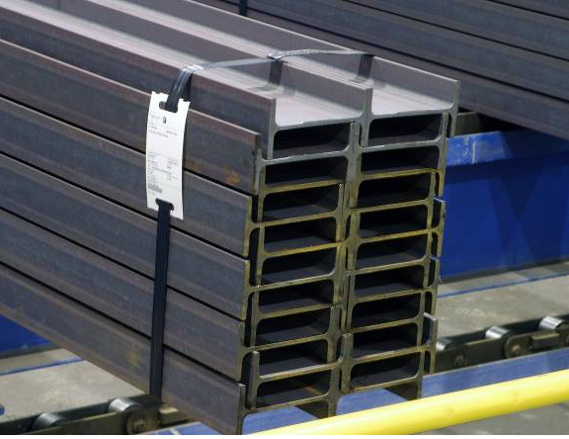
Unique: For every application the right size
115,1 mm
We roll all profiles – from the smallest to the heaviest sections in the world
Weathering steel from 235 to 460 MPa yield strength
max. 63mm flange thickness (EN 10025-5)
Since 08/2019:
S460K2W up to 63mm thickness
140 mm
Worldwide heaviest rolled section
1377 kg/m
HL920x1377 EN10365
(=UB 920x420x1377)
HD400x1299 EN10365
(=UC356x406x1299)
IPE profiles
Ready for shipment

Slide 24
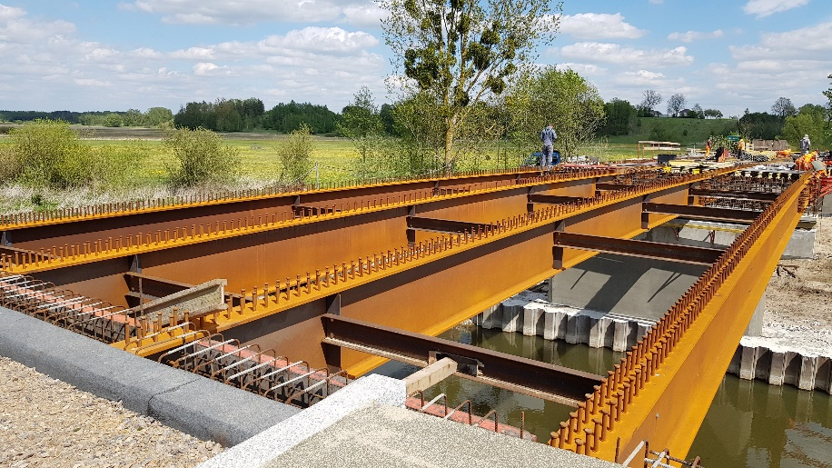
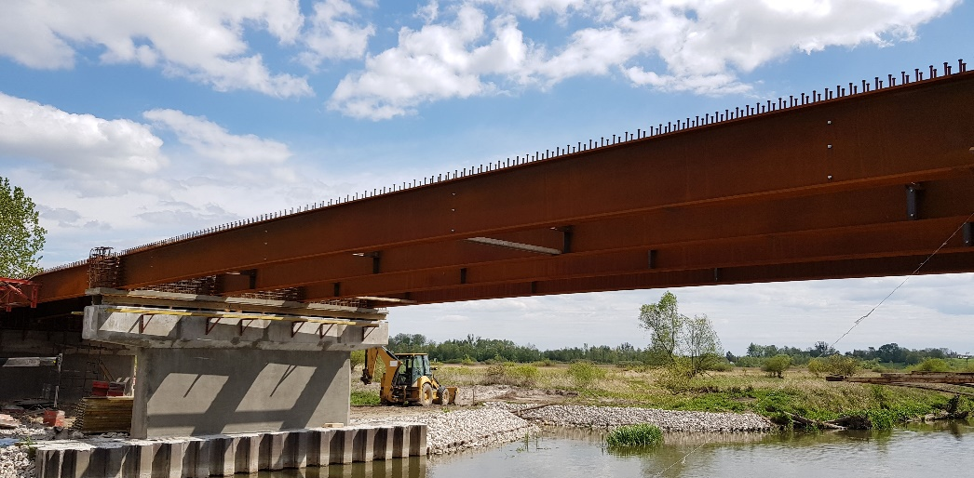
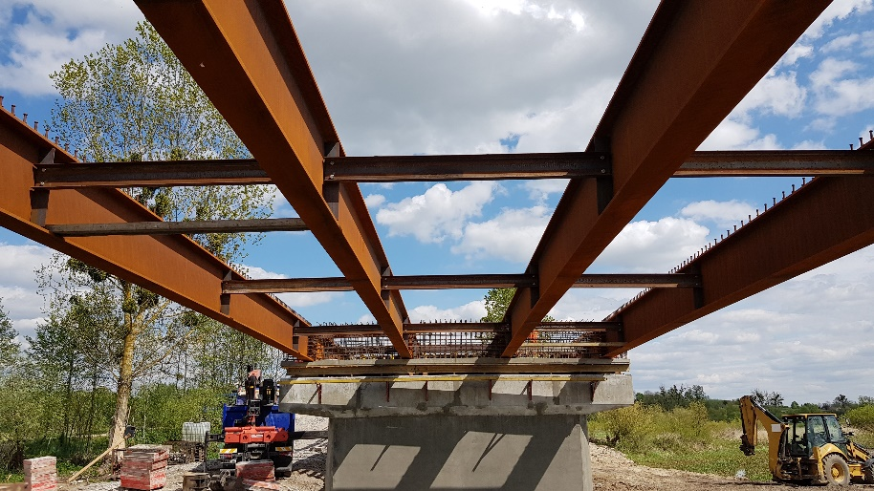
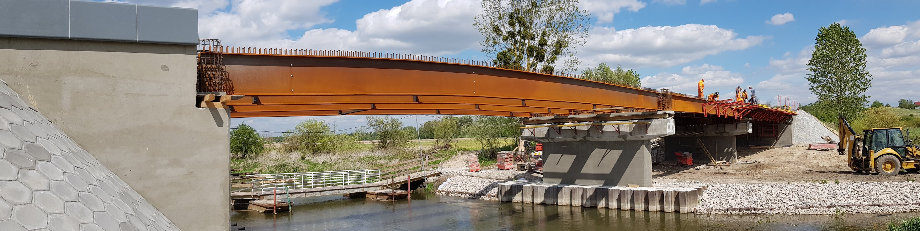
First bridge with rolled sections in S460J2W / Wirkowice (PL) bridge over river Wieprz
Aesthetic design with low life-cycle costs
HE900A (S460J2W+M)
Total length: ~56.50m (20.75 - 18.00 – 17.75 m)
Deck width: 11.20 m

Slide 25
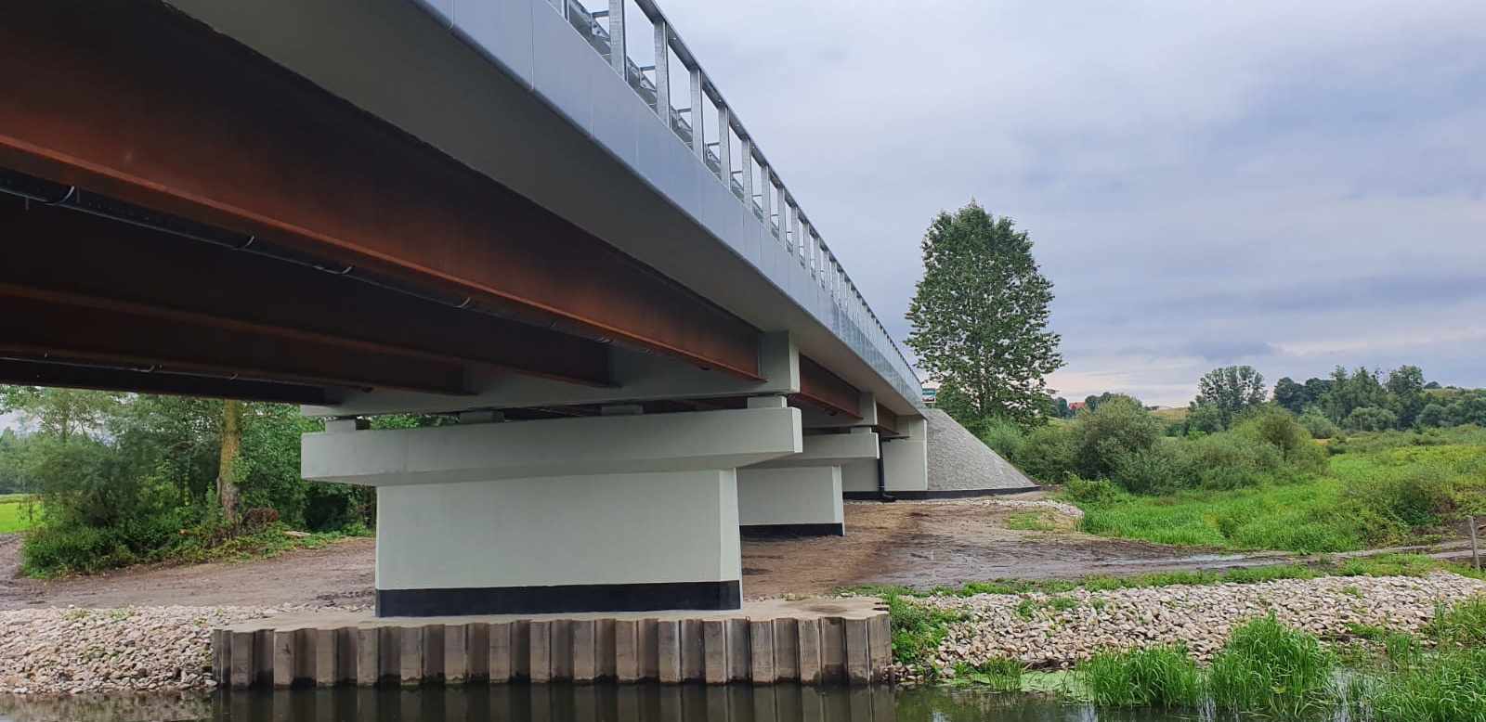

First bridge with rolled sections in S460J2W / Wirkowice (PL) bridge over river Wieprz
Aesthetic design with low life-cycle costs
Arcorox®
S460J2W+M
HE900A (S460J2W+M)
Total length: ~56.50m (20.75 - 18.00 – 17.75 m)
Deck width: 11.20 m

Slide 26
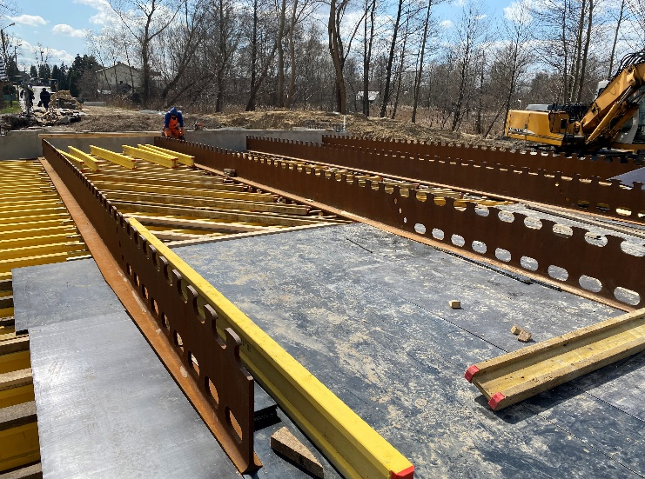
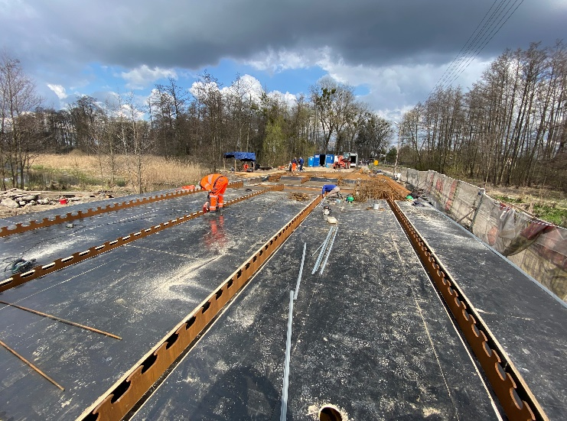
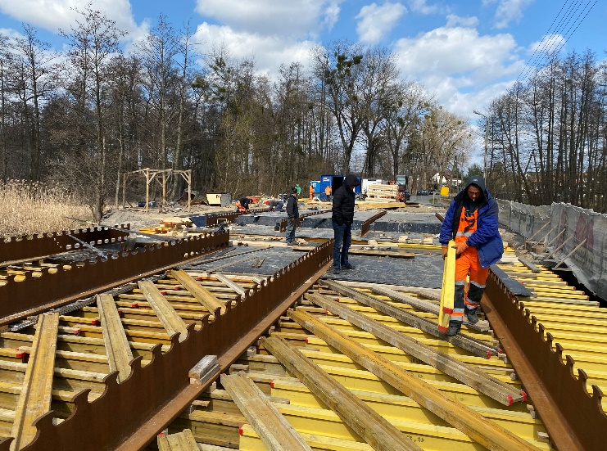
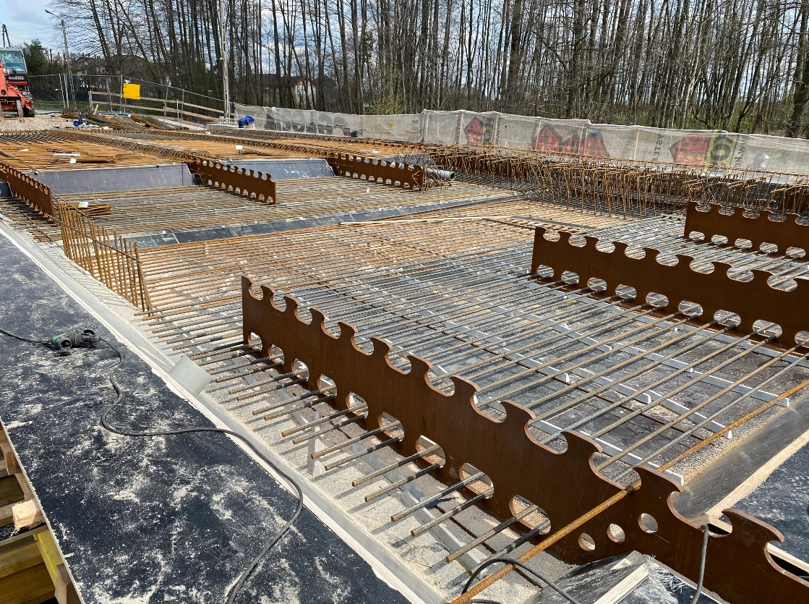


Combining PreCoBeam solution and weathering steel: a first in Europe
Bridge in the village of Biskupice, Poland

Slide 27



PreCoBeam – Design and Fabrication
Developed in RFCS-project with several European partners
Suitable for positive und negative bending moments
Examples for execution
Notes:
zwei Geometrien geregelt: die Klothoiden- und die Puzzleform, welche in den Anwendungsbereichen in Abhängigkeit von ex (Längsabstand) skalierbar sind.
Zulassung gilt für ruhende und nicht ruhende Lasten im positive als auch im negativen Momentenbereich (Betondruck und –zuggurten).
VDL kann z.B. auf ein Walzprofil aufgeschweißt werden (max. 2 Leisten) und in den Steg von Walzprofilen mittels autogenem Brennschnitt eingearbeitet werden (Mitte, rechts).
Eine besondere Bauform ist dabei der Einsatz als sogenannte externe Bewehrung in Betonplattenbalken oder in der VFT-Rail-Bauweise.

Slide 28






Bridge in the village of Biskupice, Poland / PreCoBeams from HE900B, S460J2W

Slide 29

Conclusions
Weathering steel offers many advantages due to its durability without additional corrosion protection, if the construction details are properly designed.
As the associated economic and environmental benefits are obvious, weathering steel – in particular with higher strength – is again experiencing increased popularity.
The newly developed ECCS design guide provides recommendations derived from many years of experience in combination with the latest research findings, making it a valuable tool for bridge owners and designing engineers.
Contact:
Dr.-Ing. Mike Tibolt
Steligence® Construction Engineer
Tel: +352 5313 2719
mike.tibolt@arcelormittal.com

Slide 30

Arcorox® –
Chemical composition of the product (EN 10025-5)
Cu content quite normal for steel from electric arc furnace (scrap)
Some Cr in addition
C slightly less than EN 10025-2
Notes:
Here we see the chemical composition of weathering steel
The copper concentration is almost the same as for non-alloy steel which comes out of an electric arc furnace, because of the scrap content
Chrome is in addition there,
Chrome is also responsible for the weather resistance of stainless steels
Carbon is slightly less then in part 2 steels – but this is necessary because of the desired limitation of the CEV

Slide 31

Arcorox® –
Mechanical Properties (EN 10025-5)
Mechanical Properties at ambient temperature for steel with improved corrosion resistance
➔ Same as for EN 10025-2
Notes:
As I mentioned, the mechanical properties are the same as for non-alloy steels

