Slide 1


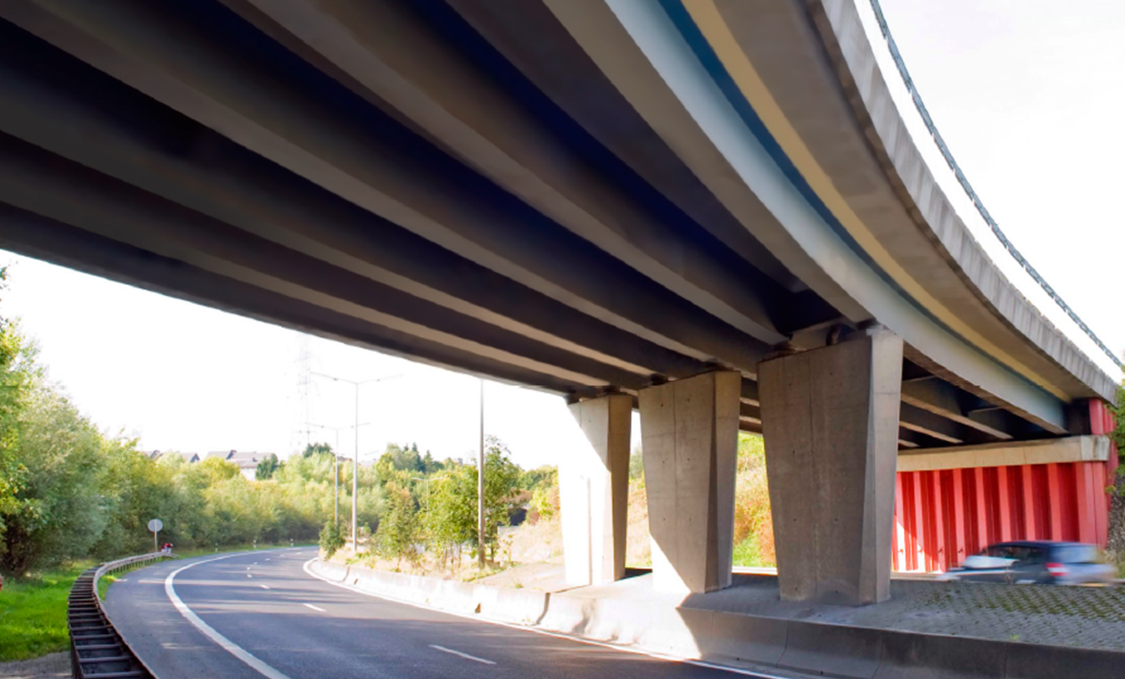
Lowering the environmental impact of infrastructures with efficient design of low carbon footprint steel solutions
June 16th 2022
Dr.-Ing Oliver Hechler
Dipl.-Ing. João Martins
Dr.-Ing. Mike Tibolt
Dr.-Ing. Dennis Rademacher
***Changing imagery***
1 Right click on the image and select ‘Change picture’
2 Choose your replacement
3 Use the crop tool to scale and position within the shape

Slide 2
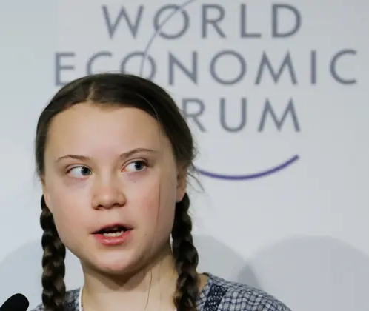
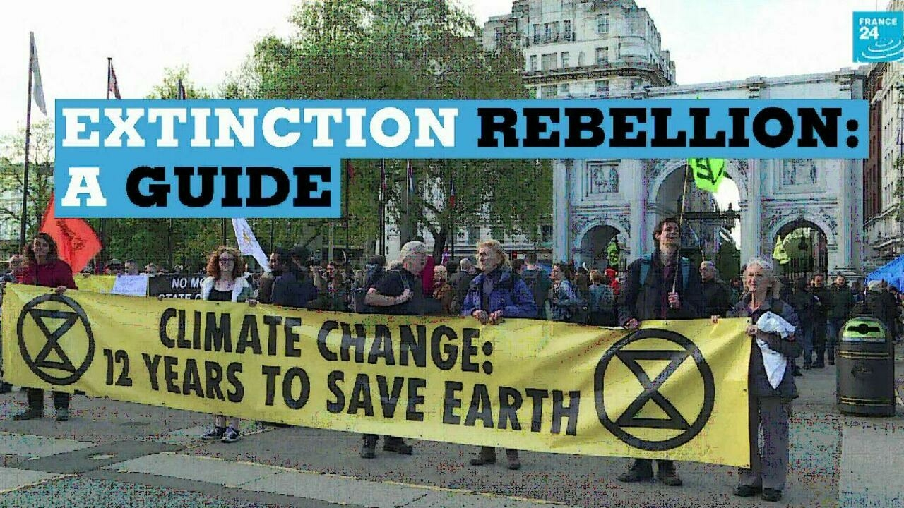

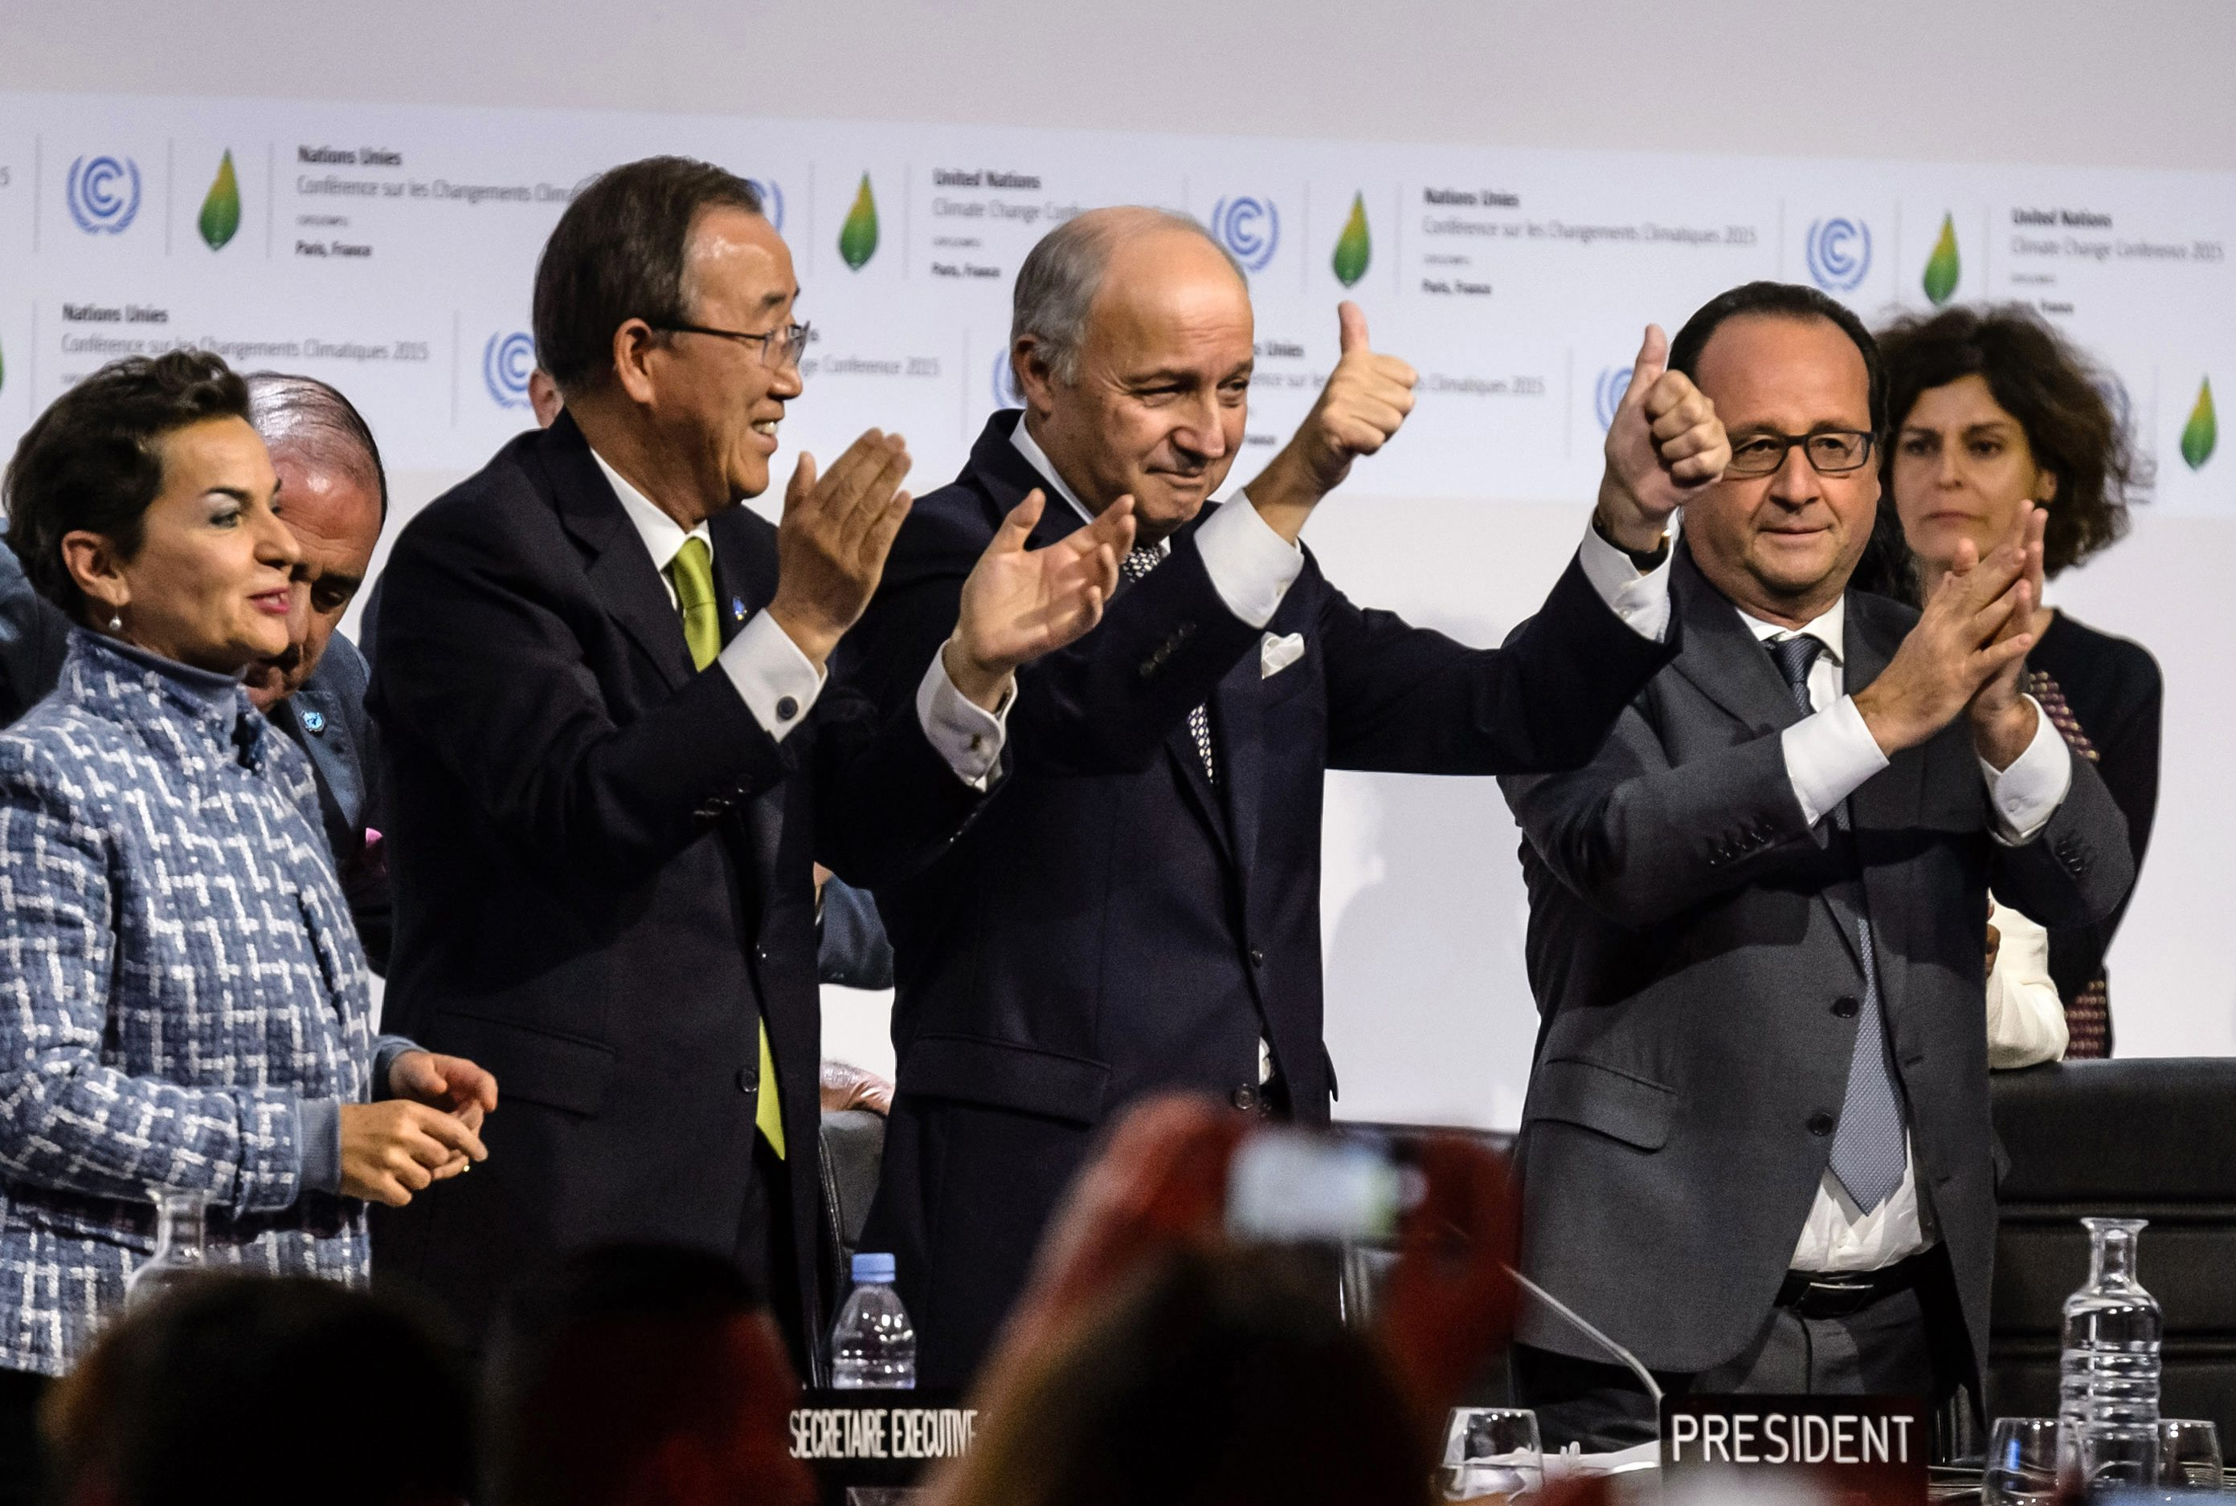
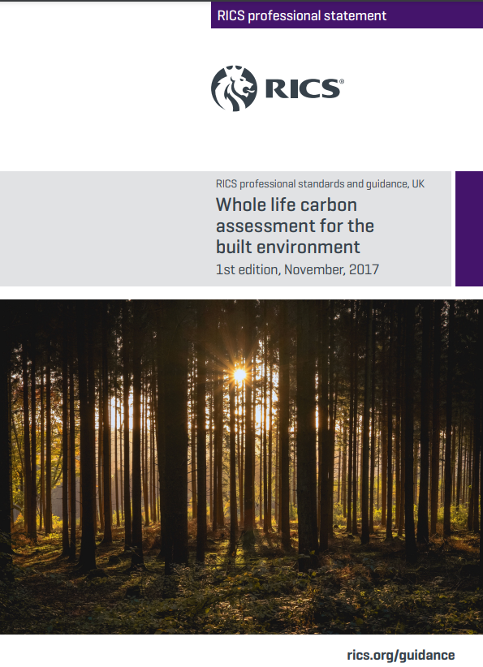
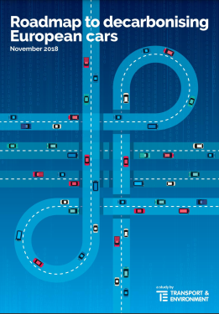

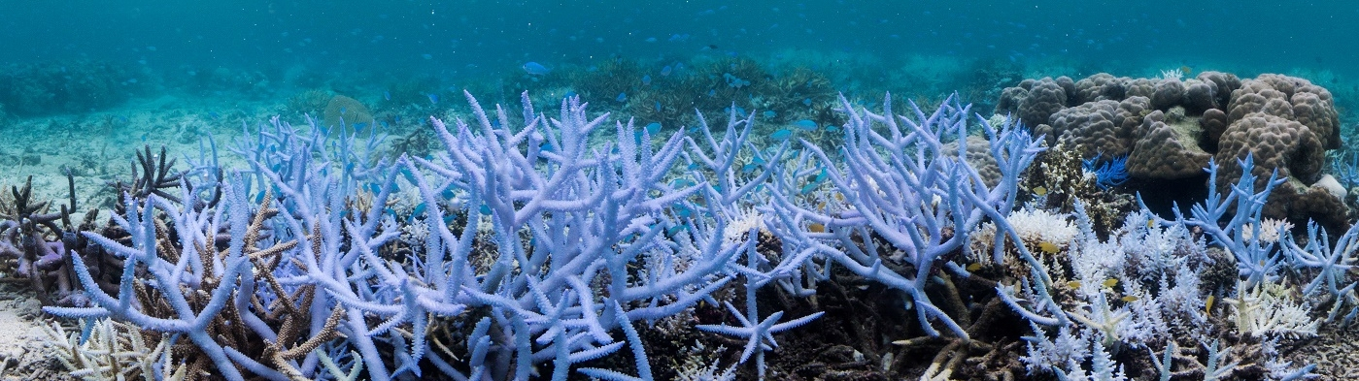
The climate emergency
Dec
Nov
Jun.
2015
2017
2018
Nov.
Apr.
Dec
2020
2019
2022
COP21. Paris Agreement.
Pursue efforts to limit the temperature increase to 1.5°C above pre-industrial levels
RICS, UK standards.
Whole life carbon
assessment
for the built environment
Greta Thunberg:
“I don’t want your hope. I want you to panic. I want you to act.
I want you to act as if our house is on fire.”
Berlin, London, NYC, Paris, Venice,…
Extinction Rebellion demonstrations
50% of Australia’s Great Barrier Reef already died across the globe since 1995 due to warmer seas driven by climate change
Pictures: https://www.unep.org/explore-topics/climate-action/facts-about-climate-emergency; Christophe Petit Tesson/European Pressphoto Agency; https://www.theguardian.com/environment/2019/jan/25/our-house-is-on-fire-greta-thunberg16-urges-leaders-to-act-on-climate; https://www.google.com/url?sa=i&url=https%3A%2F%2Fwww.france24.com%2Fen%2Fvideo%2F20190701-extinction-rebellion-civil-disobedience-direct-action&psig=AOvVaw3wk1ltopbpiHW2SyUnpoV-&ust=1631044904370000&source=images&cd=vfe&ved=2ahUKEwiBvq_ykevyAhVR8BQKHWwlC1oQjRx6BAgAEAk; https://builtenvironmentdeclares.com/
Page 2
16/06/2022
Mosty 2022

Slide 3
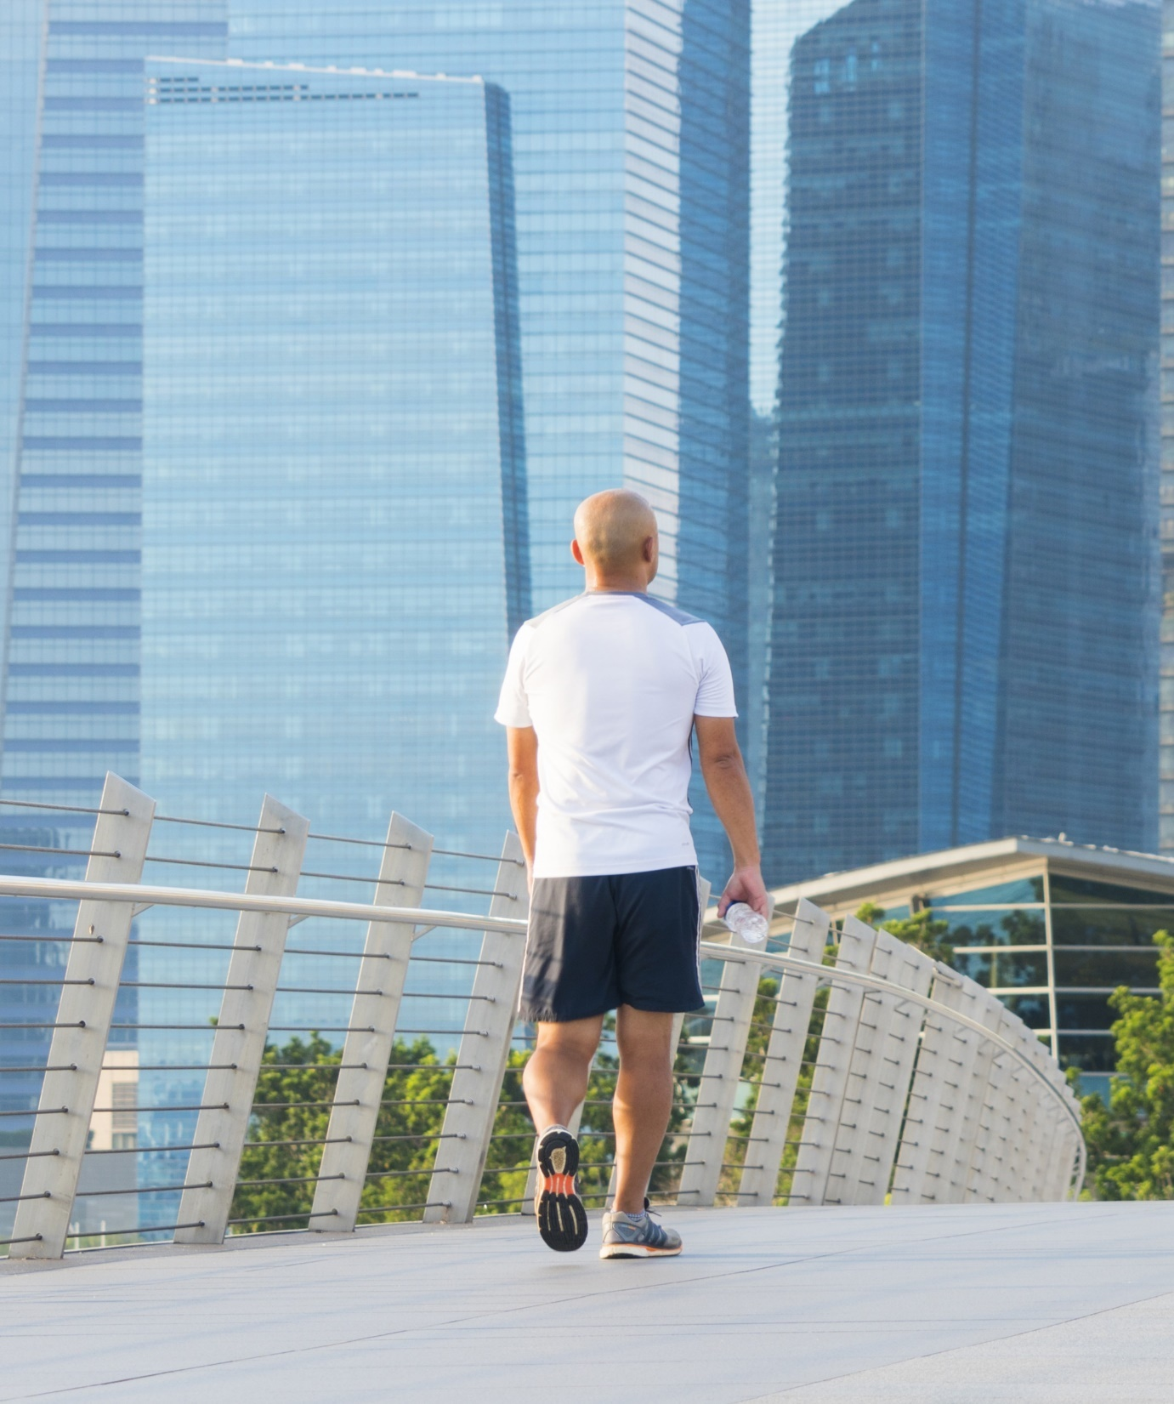

Climate emergency is a driver to decarbonise the construction market
(38% of global CO2-emissions in 2019 *)
“
By 2030, all new buildings, infrastructure and renovations will have at least 40% less embodied carbon with significant upfront carbon reduction, and all new buildings must be net zero operational carbon.
By 2050, new buildings, infrastructure and renovations will have net zero embodied carbon, and all buildings, including existing buildings, must be net zero operational carbon.
“
World Green Building Council
Extract from Bringing embodied carbon upfront
Page 3
Page 3
16/06/2022
* United Nations Organization:
2020 GLOBAL STATUS REPORT FOR BUILDINGS AND CONSTRUCTION
Mosty 2022

Slide 4
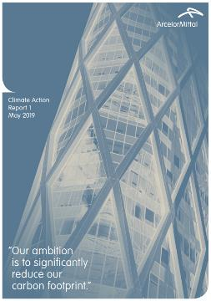
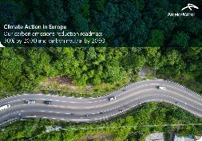



The climate emergency … and our commitment to be net zero by 2050
net zero2050
Dec
Jun.
Jun.
Jul
Nov
May
Jun.
Nov.
Apr.
Nov
Dec
2015
2017
2018
2019
2020
2021
COP21. Paris Agreement.
Pursue efforts to limit the temperature increase to 1.5°C above pre-industrial levels
RICS, UK standards.
Whole life carbon
assessment
for the built environment
Greta Thunberg:
“I don’t want your hope. I want you to panic. I want you to act.
I want you to act as if our house is on fire.”
Berlin, London, NYC, Paris, Venice,…
Extinction Rebellion demonstrations
ArcelorMittal
Climate Action report #1
CO₂ ↓ 30% by 2030
ArcelorMittal Europe
ArcelorMittal Europe
Climate Action Report
ArcelorMittal Climate Action Report #2
CO₂ ↓35% by 2030 in Europe
50% of Australia’s Great Barrier Reef already died across the globe since 1995 due to warmer seas driven by climate change
Pictures: https://www.unep.org/explore-topics/climate-action/facts-about-climate-emergency; Christophe Petit Tesson/European Pressphoto Agency; https://www.theguardian.com/environment/2019/jan/25/our-house-is-on-fire-greta-thunberg16-urges-leaders-to-act-on-climate; https://www.google.com/url?sa=i&url=https%3A%2F%2Fwww.france24.com%2Fen%2Fvideo%2F20190701-extinction-rebellion-civil-disobedience-direct-action&psig=AOvVaw3wk1ltopbpiHW2SyUnpoV-&ust=1631044904370000&source=images&cd=vfe&ved=2ahUKEwiBvq_ykevyAhVR8BQKHWwlC1oQjRx6BAgAEAk; https://builtenvironmentdeclares.com/
Page 4
16/06/2022
Mosty 2022

Slide 5
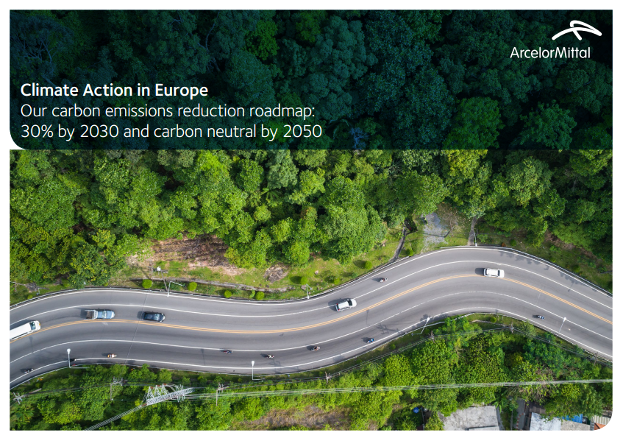

ArcelorMittal has a clear ambition to decarbonise its production
May 2019:
First group climate action report
May 2020:
European climate action report
Plans to become net-zero by 2050
July 2021:
Second group climate action report
ArcelorMittal’s ambition to significantly reduce CO₂ emissions globally and become carbon-neutral in Europe by 2050.
2030 global carbon emissions intensity reduction target of 25%
European 2030 carbon emissions intensity reduction target increased to 35% from 30% previously announced.
December 2019:
September 2020:
  ArcelorMittal Europe sets target to cut carbon emissions by 30% by 2030
  ArcelorMittal sets 2050
  net-zero target
Page 5
16/06/2022
Mosty 2022

Slide 6
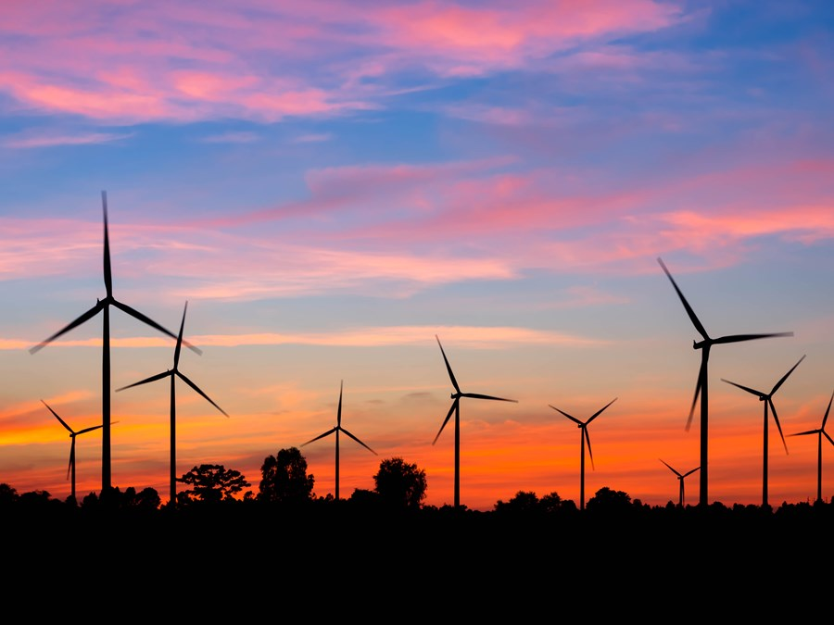
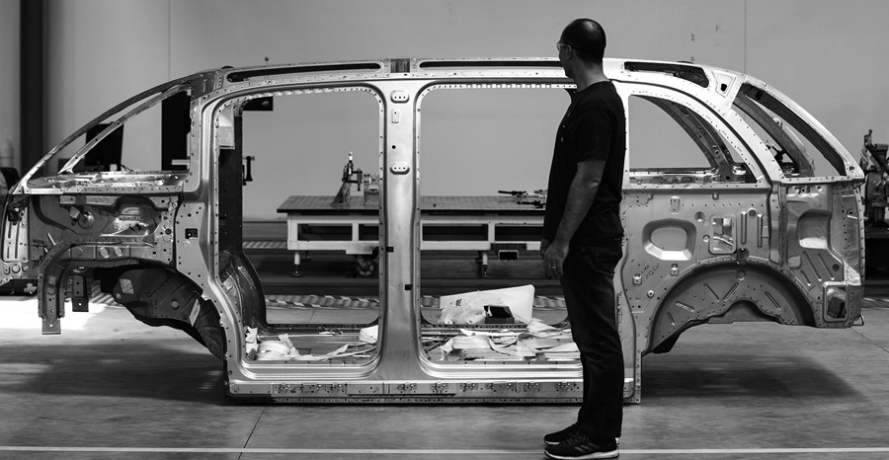
With XCarb® products, our customers benefit directly from our investments
TODAY, XCarb® has been created:
To meet the demand from customers
To take advantage of ArcelorMittal’s existing decarbonisation investments
OVER TIME
XCarb® recycled and renewably produced steel is made in the EAF using both scrap and certified renewable energy, enabling it to reach very low levels of embodied CO₂e
XCarb® green steel certificates represent real savings in our CO₂ emissions through targeted investment that can be attached to steel shipments, enabling customers to report a reduction in their Scope 3 carbon emissions
We intend to develop our portfolio of XCarb® products to enable customers to take advantage of all our efforts to decarbonise as we progress towards our net zero by 2050 target
Page 6
16/06/2022
Mosty 2022

Slide 7



Up to 100%
recycled scrap
100%
renewable electricity
XCarb® recycled and renewably produced steel has a far smaller carbon footprint than steel produced on the primary route (BF/BOF)
The average for the global steel industry is around 1.85 tonnes of CO₂-eq emissions per tonne of steel products.⁽¹⁾
Page 7
(1) World steel Association, Climate change and the production of iron and steel, 2021
16/06/2022
Mosty 2022

Slide 8

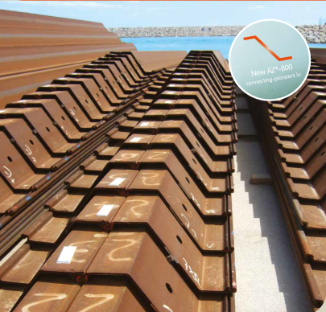


Green(er) Steel with low carbon footprint
“Cradle To Cradle” certification
EPD EcoSheetPile Plus
EPD EcoSheetPile
100%recycled (EAF)
Innovation
EPD (Environmental Product Declaration)
EPD EcoSheetPile NL
Co₂-eq / t
937
520
429
370
1990
2000
2004
2011
2015
2016
2018
2020
2021
Mass
(kg/m²)
100.0
82.6
78.4
72.2
High strength grades S430GP & S460AP
AMLoCor grade for maritime applications
Innovation
AZ range
S 355 GP
AZ-700 large / lighter sheet piles
AZ-800 extra large / extra light sheet piles

Slide 9
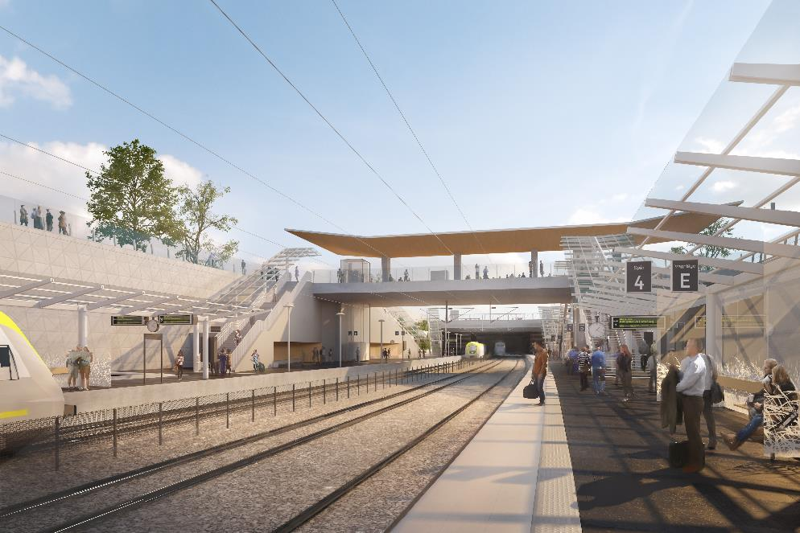



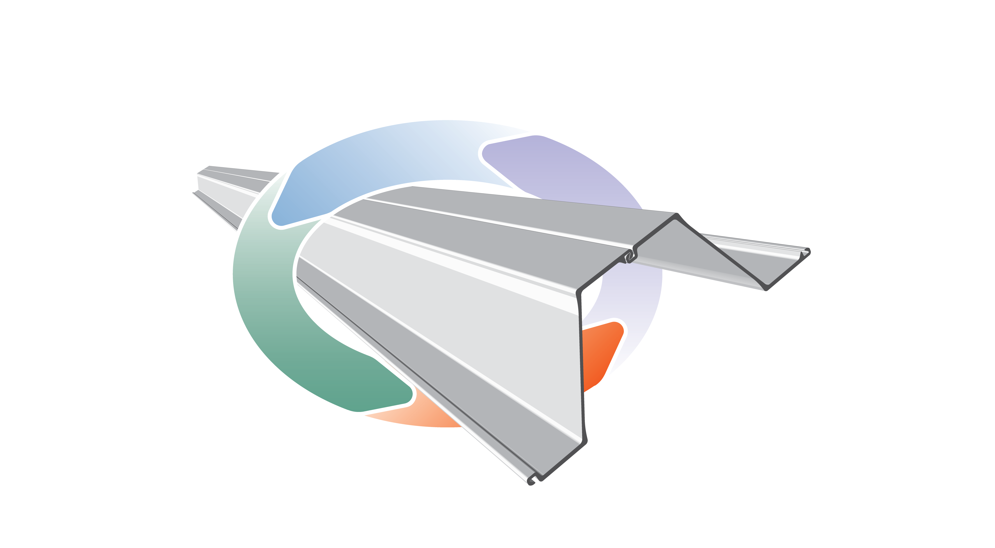
© Abako
New train station in Varberg, Sweden
1,200 t PU 22 and AZ 44-700N

Slide 10

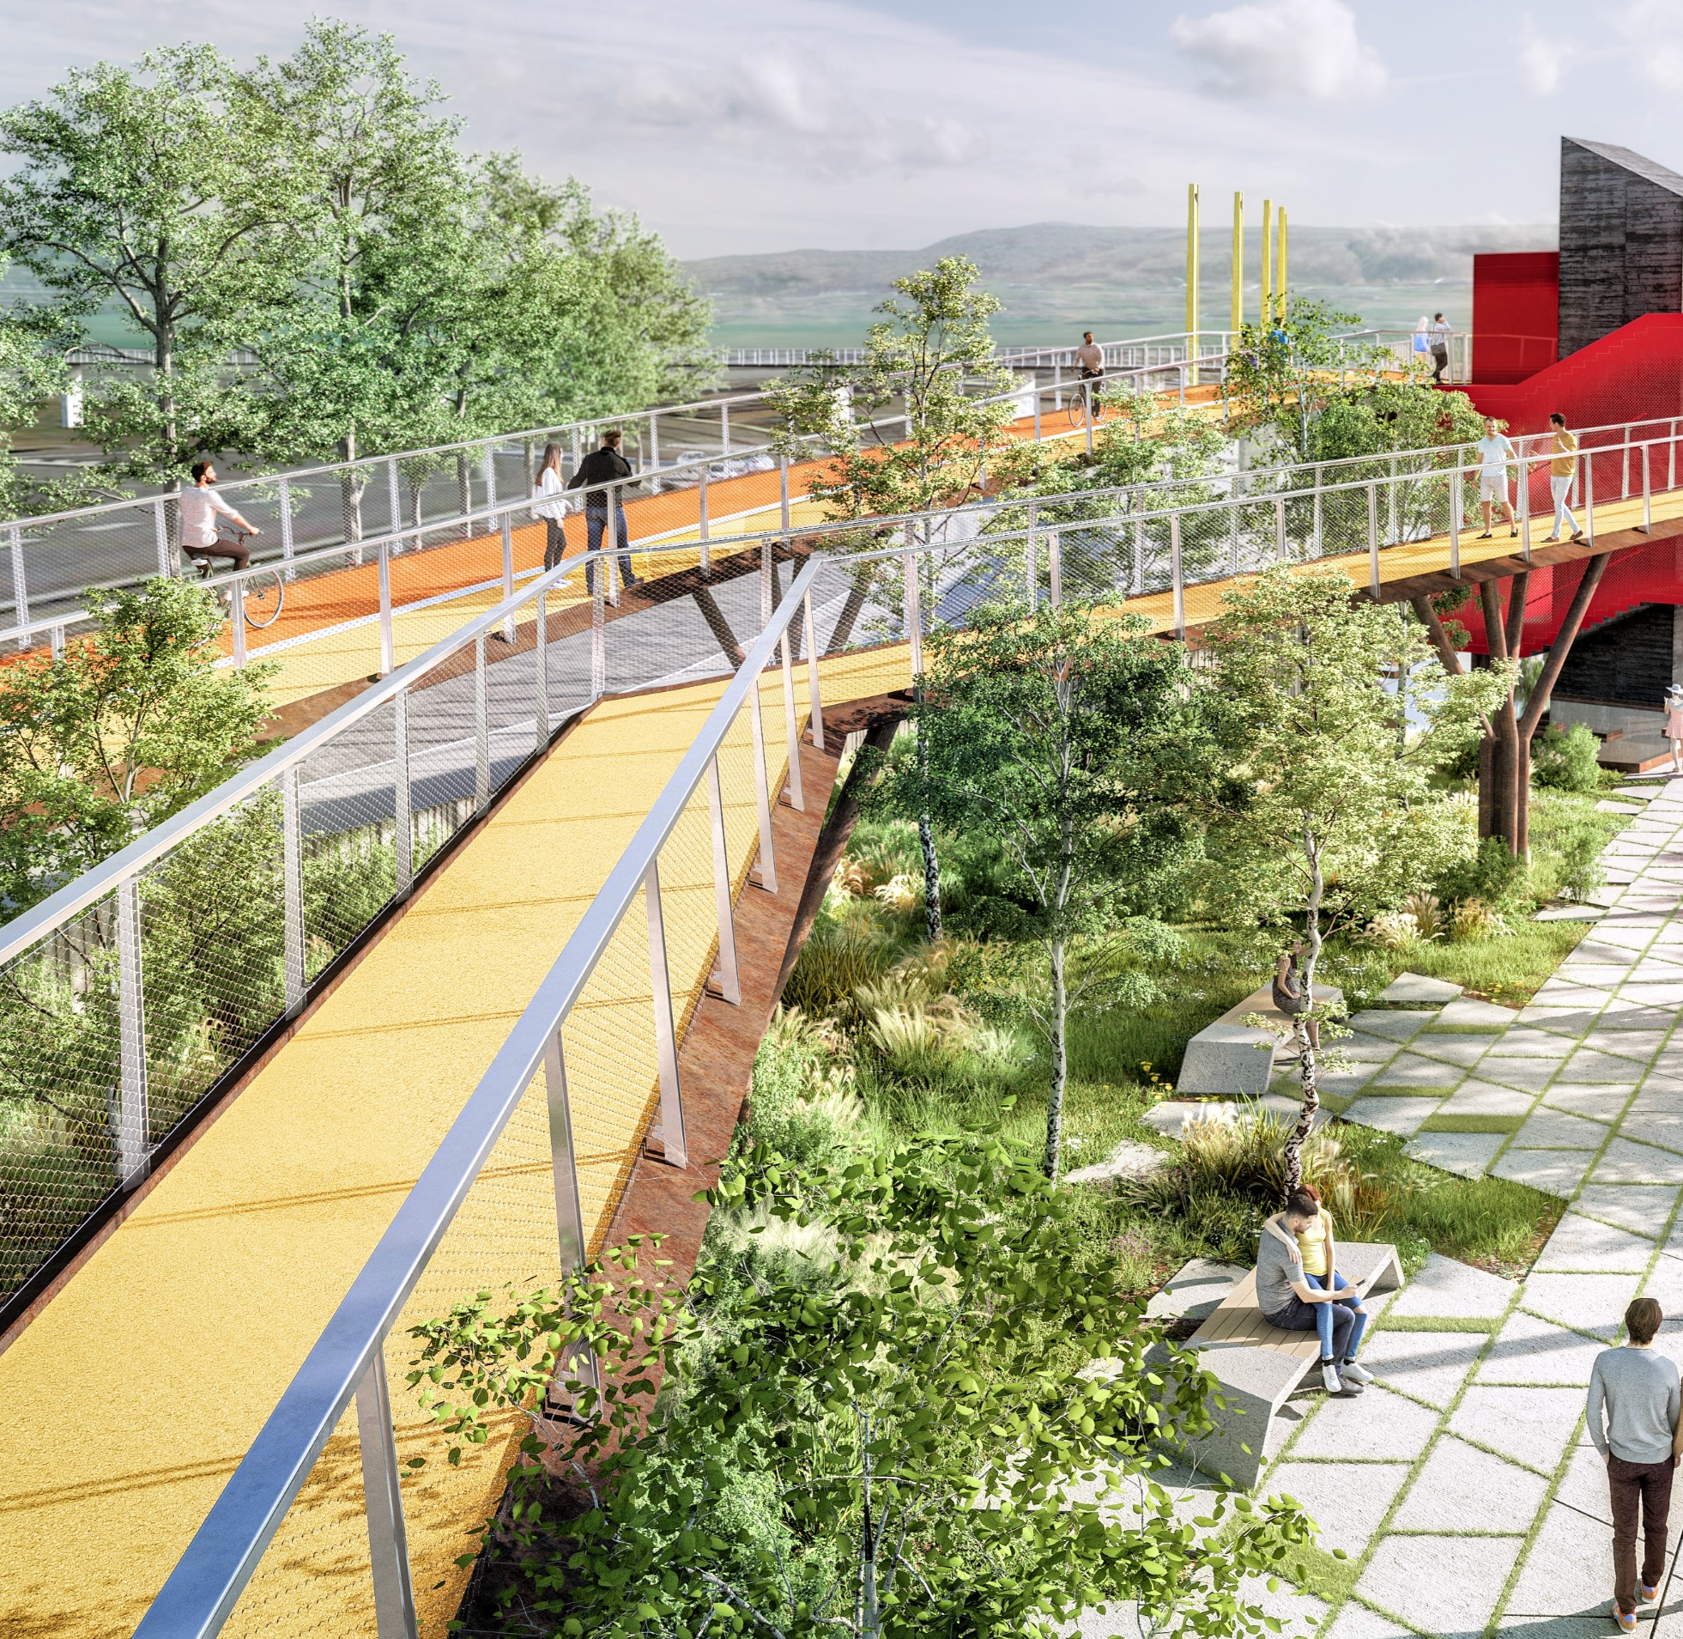

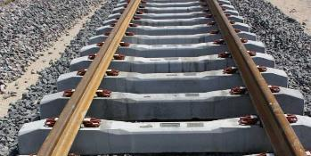
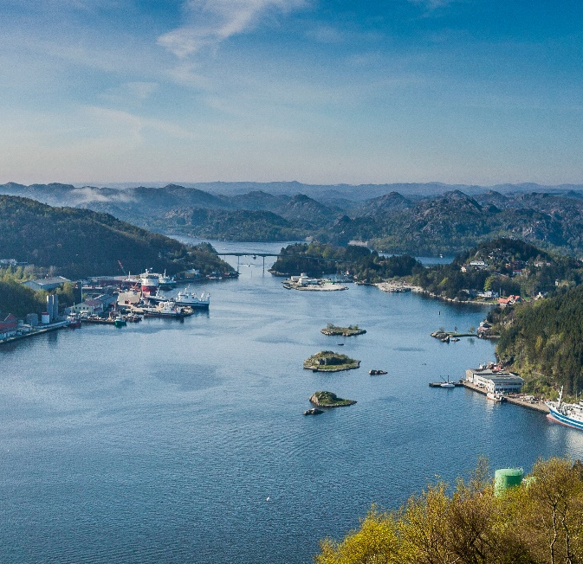
Bars and rods
First trial order in XCarb®
Hjulsbro, in Sweden.
Pre-Constrained strands producer.
Final application: railway sleepers
Sections
The longest pedestrian bridge in Europe between Esch and Belval, in Luxembourg
GWP* at: 300 kg CO₂/t steel
EcoSheetPile™ Plus
Fishing terminal in the Egersund port in Norway
GWP* at: 333 kg CO₂/t steel
GWP* at: 370 kg CO₂/t steel

Slide 11

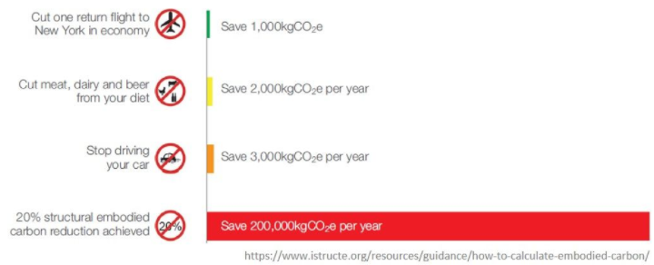





The structural engineer has more opportunity to reduce carbon emissions than most other people
The climate emergency is a driver to reduce the carbon footprint of our everyday lives…
… and even more for the structural engineer
Actions to reduce carbon footprint
Cut one return flight to New York in economy
Save 1,000 kgCO₂e
Cut meat, dairy and beer from your diet
Save 2,000 kgCO₂e
Stop driving your car
Save 3,000 kgCO₂e
20% structural embodied carbon reduction achieved (*)
Save 200,000 kgCO₂e
16/06/2022

Slide 12
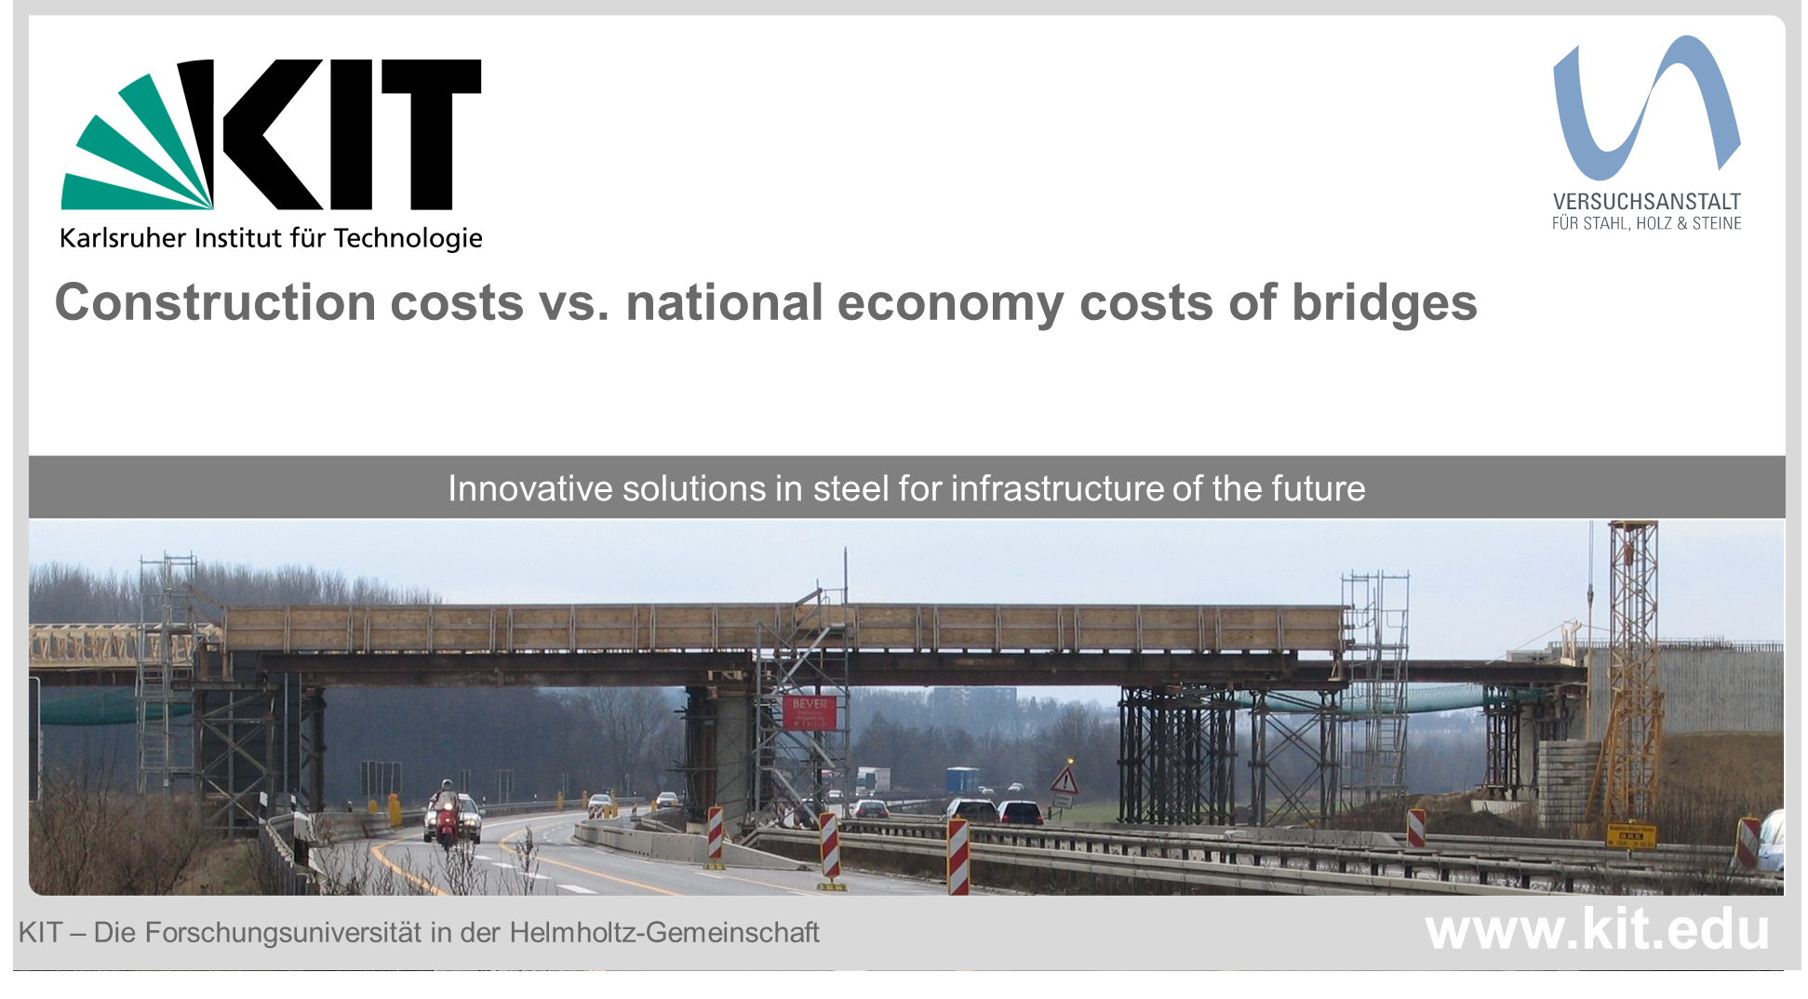
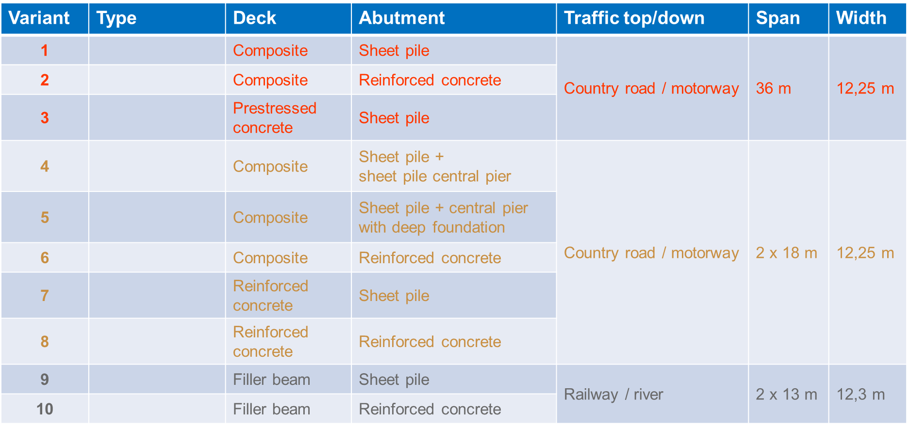
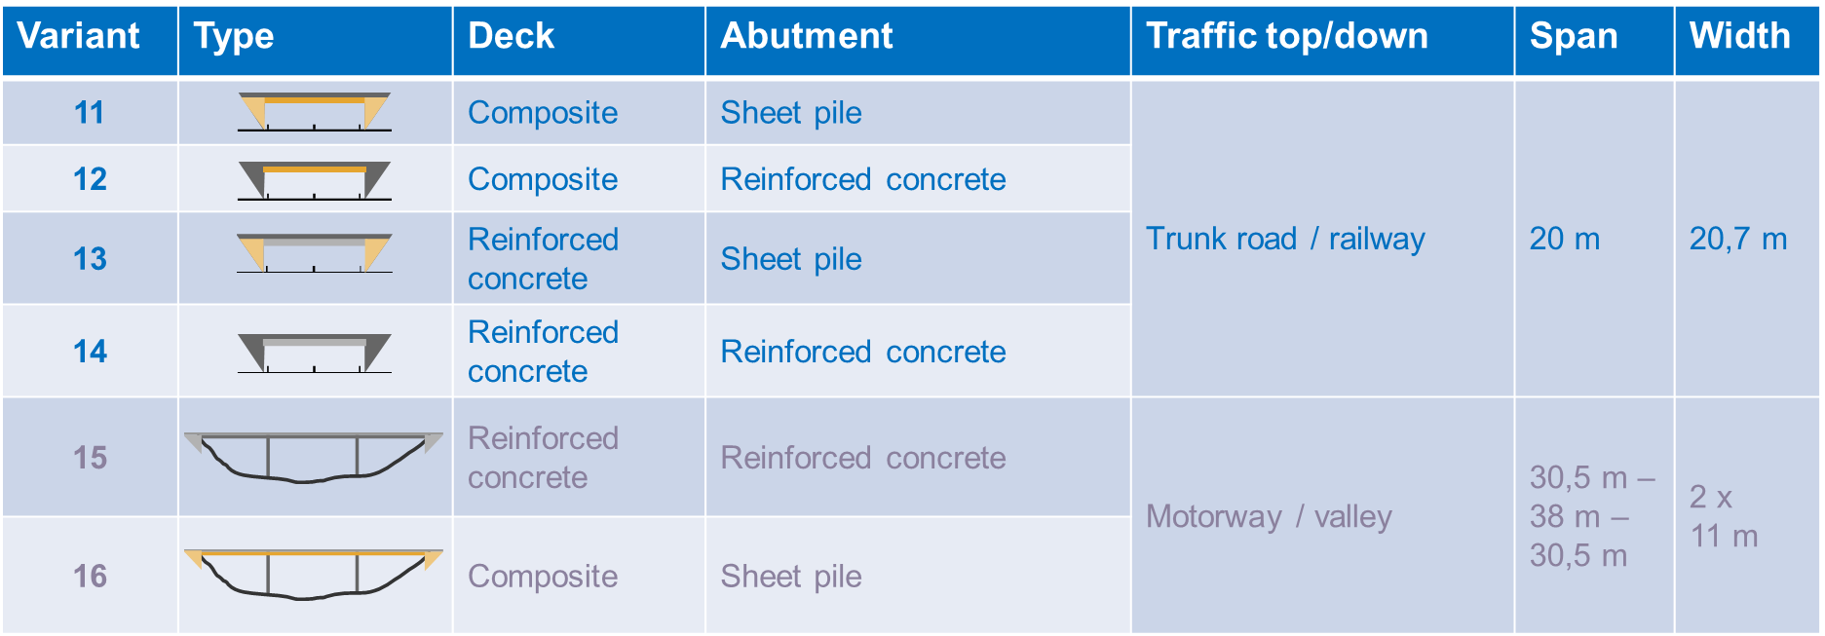
How to come from product level to reduce the carbon footprint of specific projects ?
Environmental impacts are assessed ⇒ Life Cycle Analysis (LCA)
  It encompasses the extraction of all the raw materials and their further processing, the transport, the manufacturing of the product, any additional processing before installation at the jobsite, the use phase, the dismantlement and finally the reuse or recycling of the product
An EPD is a weighted average of the environmental footprint of a product based on its diverse applications
  It is the result of several LCAs of a single product
Independent study by KIT comparing steel/steel composite solutions with concrete solutions
  Focus on environmental aspects and external costs (03/2021)
Case study 1: Varying substructure
Case study 2: Varying superstructure
D. Rademacher, A. Barceló, O. Hechler: Life-cycle and External Cost Assessment for Bridges with Small and Medium Spans. 25. MEZINÁRODNÍ SYMPOZIUM MOSTY/BRIDGES 2020. Brno, 2020.

Slide 13
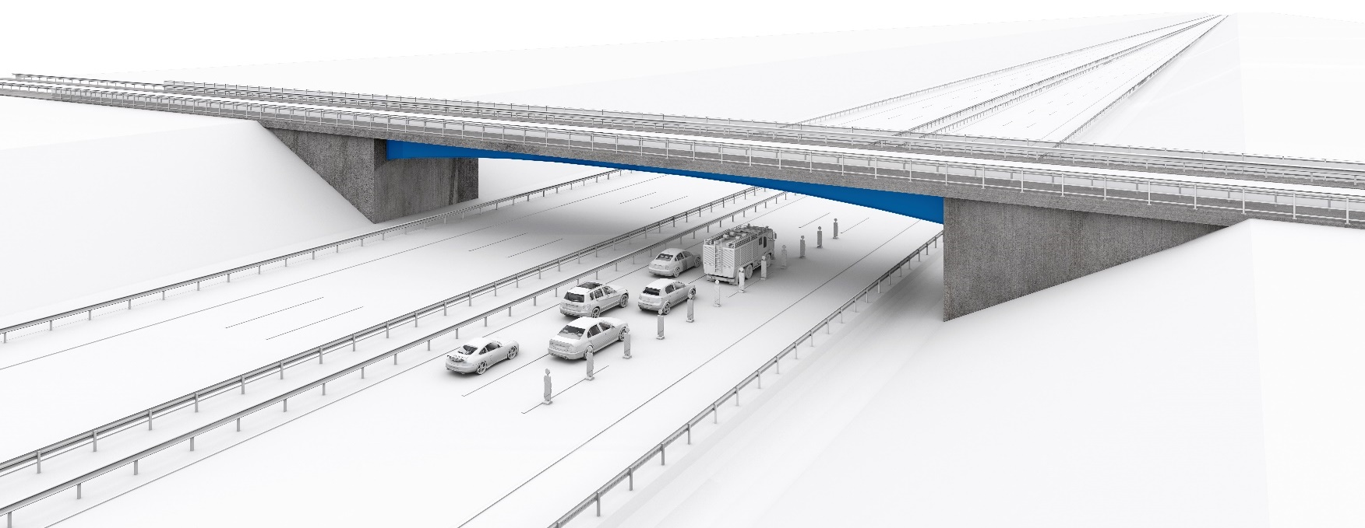
National economy costs
Deviation
Page 13
16/06/2022
D. Rademacher, A. Barceló, O. Hechler: Life-cycle and External Cost Assessment for Bridges with Small and Medium Spans. 25. MEZINÁRODNÍ SYMPOZIUM MOSTY/BRIDGES 2020. Brno, 2020.
Mosty 2022

Slide 14
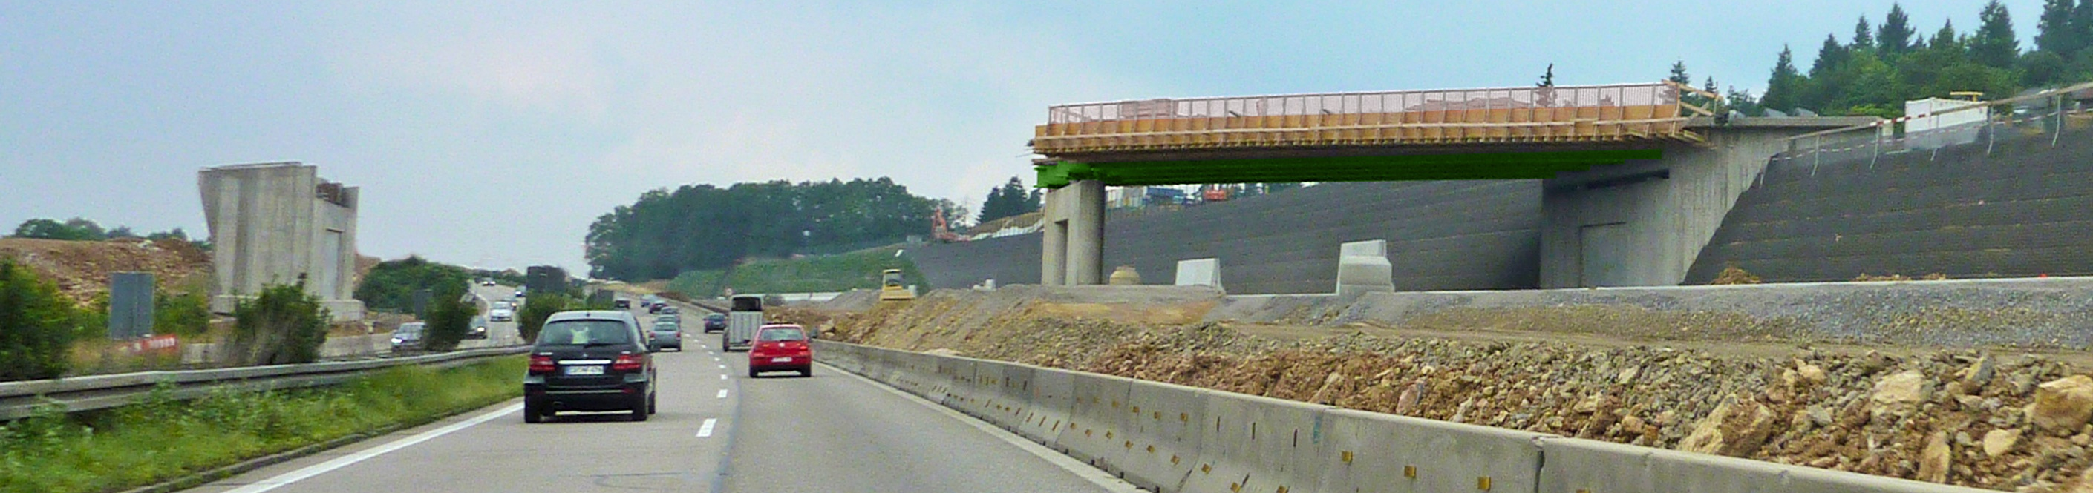
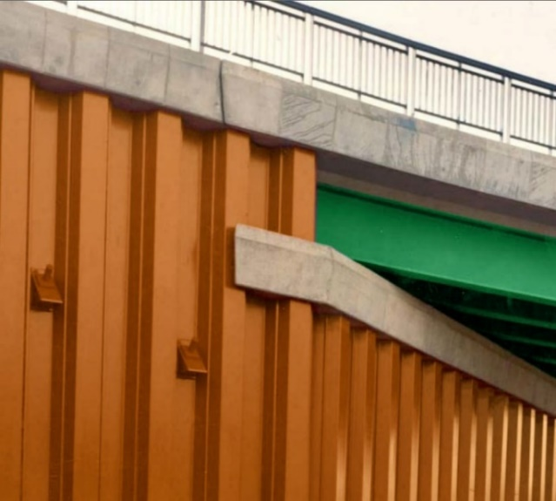
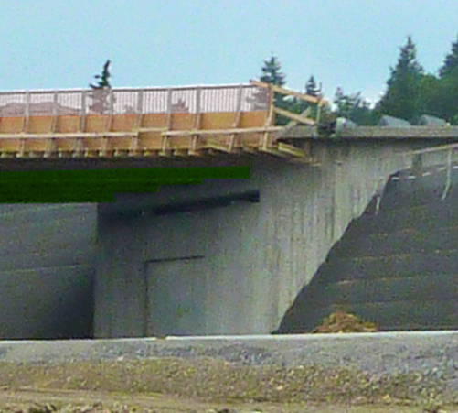

Case study 1
Varying substructure
22,5 m
22,5 m
11,5 m width superstructure
Option 1:
Sheet pile abutment
Sheet pile length of
16 m (abutment) and
13 m (wing walls)
Option 2:
Reinforced concrete abutment with concrete piles
Piles ∅=0,9m and L=10 m
2 piles per wing wall and
4 piles per abutment
Page 14
16/06/2022
D. Rademacher, A. Barceló, O. Hechler: Life-cycle and External Cost Assessment for Bridges with Small and Medium Spans. 25. MEZINÁRODNÍ SYMPOZIUM MOSTY/BRIDGES 2020. Brno, 2020.
Mosty 2022

Slide 15
Case study 1: Costs
Varying substructure
Construction costs
Life-cycle costs
External costs
2% real discount rate
DTV 70.000 Veh./day, 3-lane motorway
Temporary / Planning
Equipment
SSP abutments
Dismantling
Superstructure
Operation
Substructure
RC abutments
Construction
RiWiBrü modified
+13,5%
+14,3%
+8%
+5%
+27%
+8%
Steel sheet pile abutment
Reinforced concrete abutment
Motorway below
Country road on top
Motorway below
Country road on top
16/06/2022
D. Rademacher, A. Barceló, O. Hechler: Life-cycle and External Cost Assessment for Bridges with Small and Medium Spans. 25. MEZINÁRODNÍ SYMPOZIUM MOSTY/BRIDGES 2020. Brno, 2020.

Slide 16
Case study 1: LCA
Varying substructure
Functional unit: m² bridge area per year
Global warming potential by member group
GWP [kg CO₂-eq./(m²∙year)]
Sheet pile
abutment
Reinforced concrete abutment
Equipment
Transport:
Steel beams/sheet piles:
500 km truck
Concrete:
50 km truck
Superstructure
+12%
Substructure
+1%
+31%
+36%
Data sets used:
Sheet piles : EPD EcoSheetPiles
Concrete C20/25 - C30/37: ökobau.dat
+1%
Reinforcing steel: ökobau.dat
Corrosion protection: NaBrü-research project (GaBi data sets)
ges.
0,31
ges.
0,60
ges.
-0,29
ges.
-0,28
Production
(A1-5)
Operation
(B1-7)
Dismantling
(C1-4)
gesamt
Stahlverbund-Überbau
Recycling D
Total
16/06/2022

Slide 17
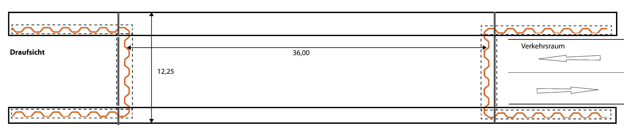
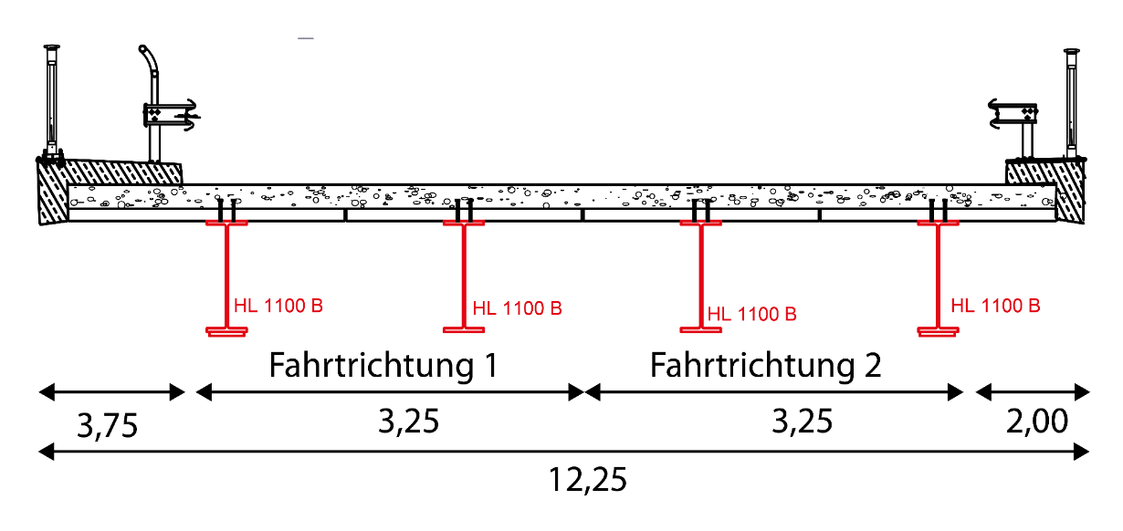
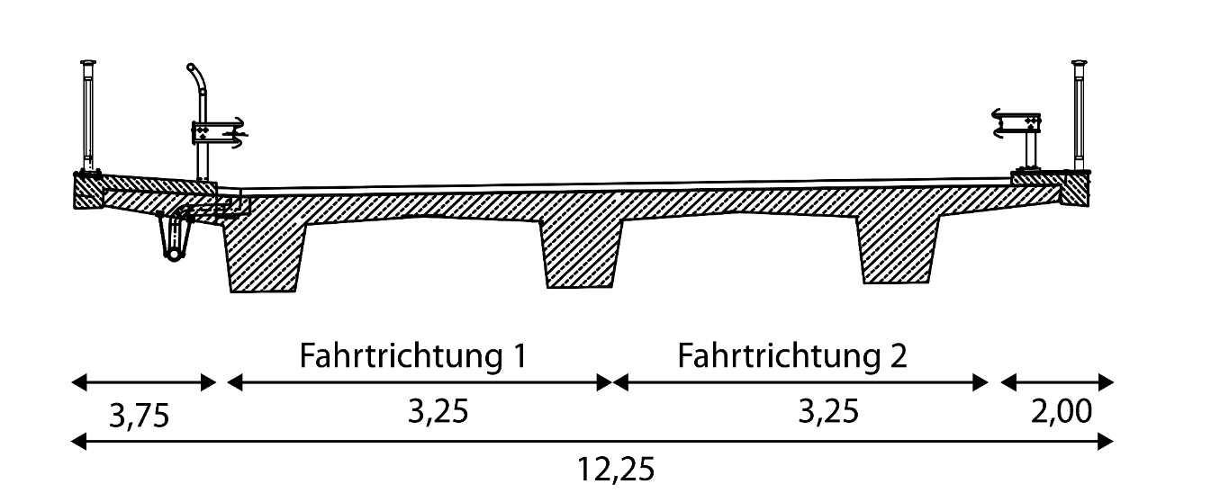
Case study 2
Varying superstructure
Plan view
Traffic area
Single span bridge with steel sheet pile abutments
Variant 1:
Steel composite deck (S460)
Variant 3:
Prestressed concrete (in-situ)
Traffic direction 1
Traffic direction 2
Traffic direction 1
Traffic direction 2
Page 17
16/06/2022
D. Rademacher, A. Barceló, O. Hechler: Life-cycle and External Cost Assessment for Bridges with Small and Medium Spans. 25. MEZINÁRODNÍ SYMPOZIUM MOSTY/BRIDGES 2020. Brno, 2020.
Mosty 2022

Slide 18
Case study 2: Costs
Varying superstructure
Construction costs
Life-cycle costs
External costs
2% real discount rate
DTV 70.000 Veh./day, 3-lane motorway
Temporary / Planning
Equipment
Dismantling
Superstructure
Steel composite deck
Operation
Substructure
Prestressed concrete deck
Construction
+37%
+1%
-2%
+27%
+96%
+1%
Steel composite deck
Prestressed concrete deck
Motorway below
Country road on top
Motorway below
Country road on top
16/06/2022
D. Rademacher, A. Barceló, O. Hechler: Life-cycle and External Cost Assessment for Bridges with Small and Medium Spans. 25. MEZINÁRODNÍ SYMPOZIUM MOSTY/BRIDGES 2020. Brno, 2020.

Slide 19
Case study 2: LCA
Varying superstructure
Functional unit: m² bridge area per year
Global warming potential by member group
GWP [kg CO₂-eq./(m²∙year)]
Steel-composite
beams
Prestressed concrete beams
Transport:
Steel girders / sheet piles
500 km truck
Concrete
50 km truck
Equipment
+3%
Superstructure
Substructure
A 5 Erection (0,26)
A 4 Transport (0,08)
+1%
A1-3 Product manufacturing (2,56)
+12%
+20%
Data sets used:
Steel sections HISTAR: EPD
Concrete C20/25 - C30/37: ökobau.dat
Renewal corrosion protection steel girders
+1%
Reinforcing steel: ökobau.dat
Corrosion protection: NaBrü-research project (GaBi data sets)
ges.
0,28
ges.
0,35
ges.
-0,02
ges.
-0,18
Production
(A1-5)
Operation
(B1-7)
Dismantling
(C1-4)
Recycling D
Total
Stahlverbund-Überbau
Page 19
16/06/2022
Mosty 2022

Slide 20
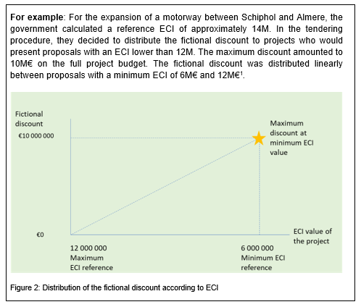
How to value these efforts by construction industry ?
Green credentials should be considered in public tenders
Prime example: Netherlands
  Systematic enforcement of environmental criteria in a scheme for public tenders that lead to the most sustainable solution, based on the most economically advantageous tender
  Use of the monetization scheme, which is based on a weighting method applied to multiple environmental indicators either from national EPDs or from generic data contained in a national database
  The calculated overall ECI (Environmental Cost Indicator) comprises the quantities of the materials having a large repercussion on the environmental footprint of the project and is converted into a financial credit that is subtracted from the overall price.
  Thus, the contract is not necessarily awarded to the contractor with the lowest bid (price)
6,67 M€
8,0 M€

Slide 21
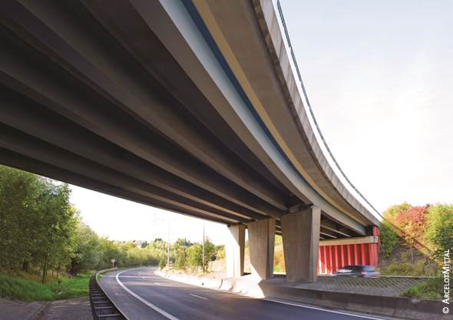
Summary and conclusions
Greenhouse gases to be reduced
⇒ infrastructure projects
ArcelorMittal has launched XCarb® to lower the environmental impacts of products / projects
A holistic approach for infrastructures is essential
⇒ Life Cycle Analysis (LCA)
LCA example “bridge foundation”:
  External costs: -12 %
  GWP (modules A1-A5): - 13 %
LCA example “bridge superstructure”:
  External costs: -24 %
  GWP (modules A1-A5): - 6 %
Further potential with XCarb® recycled and renewably produced steel: - 30-35 % (A1-A3)
Effort to reduce the carbon footprint
must be valued in tendering

Slide 22
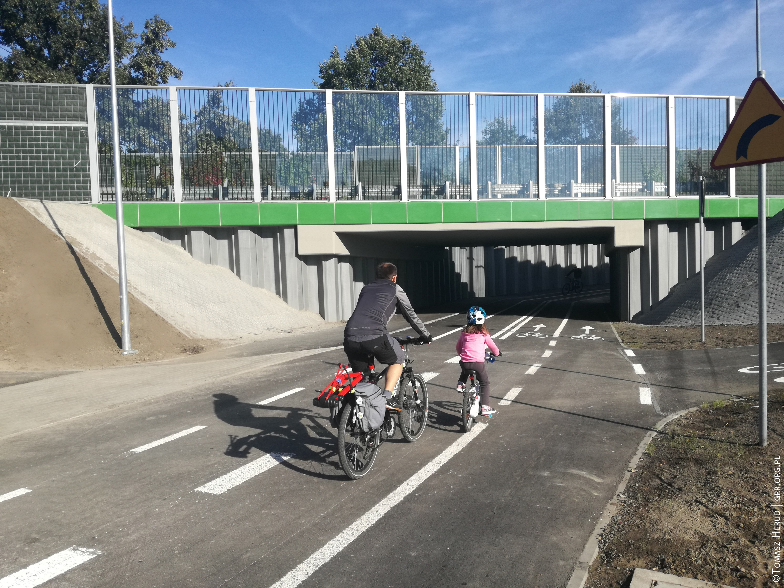
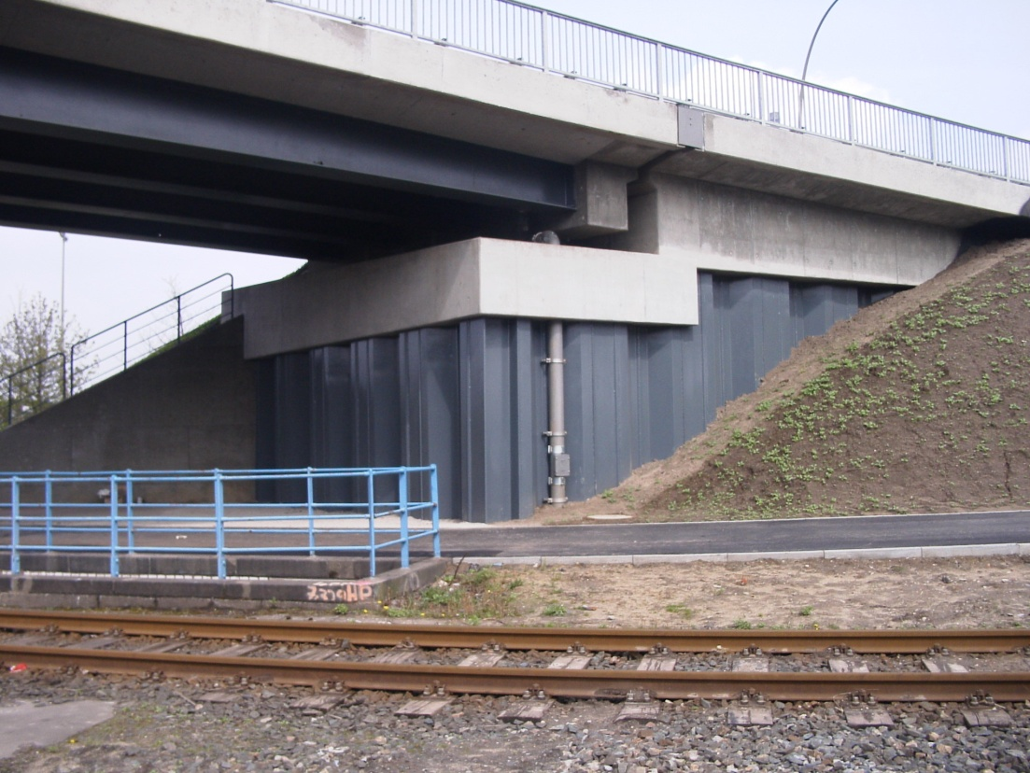
Thanks for your attention and let’s stay connected !

